Slide 1
Automation of Programmes & Services
Module 3
www.leaderseeds.eu

Slide 2
Outline
01
Business Process Management (BPM)
“Everyone can be great because everyone can serve.”
– Martin Luther King Jr.
02
Customer Relationship Management (CRM)
03
Search Engine Optimization (SEO)
04
Cloud
05
Agile Methodologies
06
References

Slide 3
Introduction
The Covid pandemic has increased the number of organisations that need to implement business automation strategies. Many TSO’s, increase their risk to be get left behind if they fail to implement business automation strategies.
In this course, TSO leaders will learn how digital automation can optimize an organization's processes, what the capabilities of automation software are, and the key elements of effective automation software.
They will also learn how to map out an automation strategy, as well as learn about best practices for creating and implementing an automation strategy.

Slide 4
Instructional & Learning Objectives
Learning Goal:
Learners will understand the role of the automation of business programs and services, as well as the different technological tools that can be applied to business processes to help organizations achieve this automation.

Slide 5
Instructional & Learning Objectives
Instructional Objectives:
Learners will be introduced to Business Process Management (BPM), Customer Relationship Management (CRM), Search Engine Optimisation (SEO), Cloud software tools, and Agile Methodology.
Leaners will be instructed in graphic design, digital communication strategies, paid and targeted advertising, and data analytics.

Slide 6
Instructional & Learning Objectives
Learning Objectives:
Learners will be able to understand how Business Process Management (BPM) works continuously on the design, modelling, organisation, optimization, and documentation of processes; and thus how BPM works in TSOs.
Learners will gain knowledge of how Customer Relationship Management (CRM) can be used to obtain information from partners, donors and beneficiaries’ partners, donors, and beneficiaries analysing trends and marketing and communication.

Slide 7
Instructional & Learning Objectives
Learning Objectives (Cont.):
Learners will gain an awareness of how Search Engine Optimization (SEO) can be used to optimize web pages and position them in the lists of search engines such as Google.
Learners will be able to understand how to effectively manage the use of cloud computing; as well as understand and measure the risk Cloud utilisation.

Slide 8
Instructional & Learning Objectives
Learning Objectives (Cont.):
Learners will gain knowledge of Agile methodologies such as: Lean, Scrum, Kanban, Agile Inception, Design Thinking, and Design Sprint.
Learners will be able to monitor what is working and identify possible gaps while communicating internally and externally.

Slide 9
Competencies Gained
Knowledge of the process of automation, the benefits and the challenges
Recognise methods software automation optimizes business processes
Knowledge about the Business Process Management and how it can be applied in the Third Sector
Knowledge about Customer Relationship Management

Slide 10
Competencies Gained
Awareness about the Search Engine Optimization process
Knowledge about Cloud computing and awareness of the associated security risks
Introduction to agile methodologies
Once your organisation has a process automation strategy in place, identify best practices for ensuring the successful implementation of an automated software strategy

Slide 11
Module Duration
2-3 hours content (please allocated time devoted to theoretical part, exercises and individual work)

Slide 12
What Is the Process of Automation?
The process of automation: The use of technology to automate complex business processes. It includes three main functions:
Automating processes
Centralising information
Reducing the requirement for input from people

Slide 13
The Benefits of Automation
Transparency in management
Improving productivity
Increasing compliance
Reducing costs
Better utilization of staff
Less errors

Slide 14
The Challenges of Automation
Identifying what can be automated
Optimising all processes before the process of automation

Slide 15
Automation in the Third Sector
Automation can help Third Sector organization operating with limited budget/funding by enable staff to work less on automated tasks.
Automated services offered to vulnerable groups of people; people in need for help will be able to get quicker responses.

Slide 16
The Case of Amelia:
Amelia is a virtual member of staff that interacts with people via voice of text; she does not need to be programmed with answers; you just feed her information, connect her with your CRM systems and she finds answers.
She is also sensitive to emotion and she can tail responses accordingly.

Slide 17
The Basic Steps of Automation
To automate common processes it requires:
Invoicing
Sales orders
Accounting reconciliation
Data entry

Slide 18
The Basic Steps of Automation
To automate common processes it requires (Cont.):
System queries
Payroll
Employee or vendor on-boarding
Staff terminations

Slide 19
Which Processes Should You Automate?
Not every task can be automated. Therefore, it is important to know those that should be:
High-volume of tasks
Multiple people required to execute tasks
Time-sensitive nature
Significant impact on other processes and systems
Need for compliance and audit trails

Slide 20
01
Business Process Management (BPM)

Slide 21
Business Process Management vs. Business Process Automation
Business process automation is not to be confused with business process management, which is a larger discipline involving the management of complex organisation-wide processes using different methodologies.
Business process automation refers to the use of technology to execute recurring tasks or processes in an organization where manual effort can be replaced. It is done to minimize costs, increase efficiency, and streamline processes.

Slide 22
What Is Automation?
Service automation is the process of integrating all domain and functionality tools into various automation layers in order to have unified interface for all workflows.
It is also the process of automating events, processes, tasks and business functions.
Service automation helps in achieving multi-dimensional visibility into businesses and helps in streamlining the service process.

Slide 23
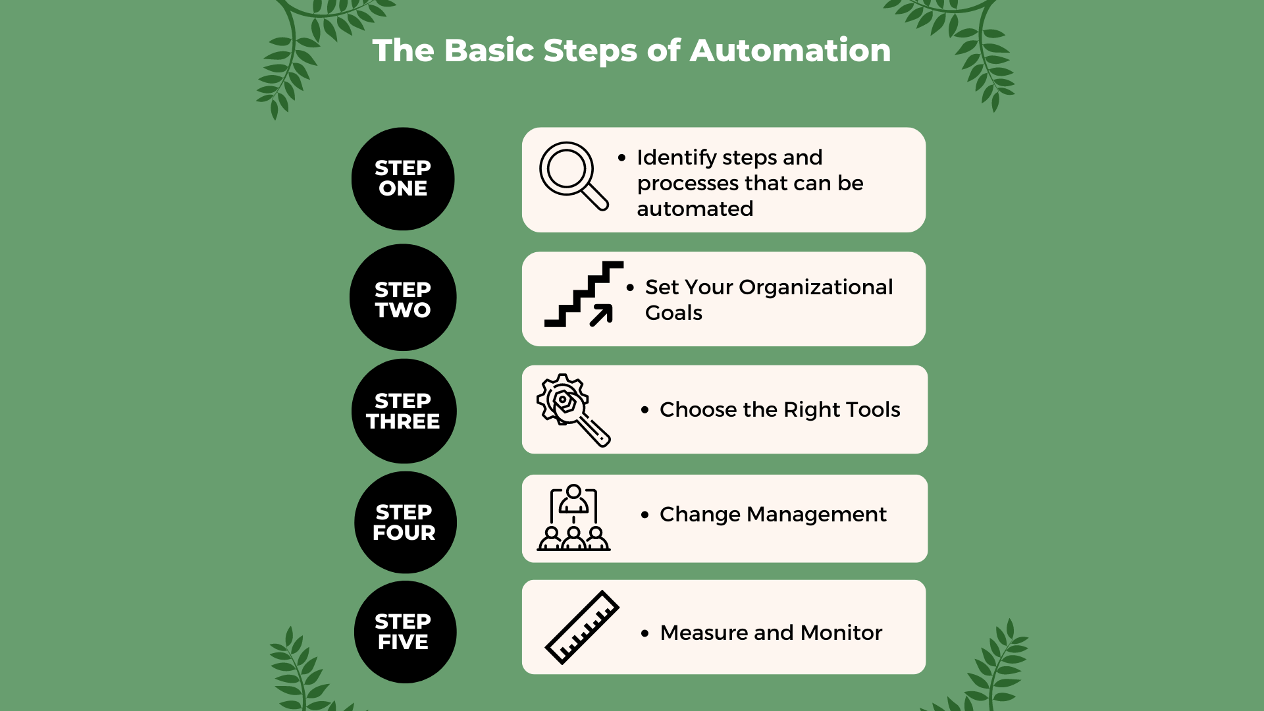

Slide 25
“It’s more effective to do something valuable than to hope a logo or name will say it for you.”
Jason Cohen

Slide 26
The Complete Guide to Business Process Automation
A Study (2018, Forrester) showed that until 2018 up to 22% of businesses have yet not processed excellence and workflow automation.
The example of employee onboarding:
Workflow automation supports efficient employee onboarding by delivering a standardized experience for every hire.

Slide 27
The Complete Guide to Business Process Automation
The example of employee onboarding (Cont.):
Electronic onboarding prevents mistakes and wraps up employee forms and compliance documents ahead of their start date.
Positive impression on new team members and increased efficiency for your onboarding team.

Slide 28
The Four C’s of Employee Onboarding
1. Compliance: the most fundamental level of onboarding process. It includes teaching employees basic legal and policy-related regulations.
2. Clarification: ensures employees fully understand their new job and all related expectations.
3. Culture: is a broad term and includes providing employees with a sense of organizational norms — both formal and informal.
4. Connection: refers to establishing the vital interpersonal relationships and information networks.
(Tanya N. Bauer, 2010)

Slide 29
Case in Point
The Efficient Employee Onboarding Processes Case
Creating an HR committee
Conducting research and making changes
Mailing a pre-boarding package

Slide 30
Case in Point
The Efficient Employee Onboarding Processes Case (Cont.)
First-day tour of the facility and meeting with senior leadership
Creating a buddy system

Slide 31
Case in Point
Things to consider
What are the alternatives if your organisation does not have a dedicated HR function?
Have you developed an onboarding system?
Is your onboard tour scripted?

Slide 32
The Benefits of Business Process Automation
Stepping stone to digital transformation
Get more clarity
Streamline processes
Get compliance records
Transparency

Slide 33
The Benefits of Business Process Automation (Cont.)
Standardise operations
Increase customer satisfaction
Productivity boost
Ability to monitor various processes on the go
Cost reduction in the long-term

Slide 34
Best Practices for Business Process Automation
Start with a clear understanding of what tasks are involved, who is responsible, and when each task is to be executed.
Ensure that you have clearly defined goals when you automate a business process. This will save a lot of time in course correction.
Measure results with a phased approach. Many organizations are disappointed when the results do not materialize overnight.

Slide 35
Business Process Management (BPM)
Definition: BPM is how a company creates, edits and analyses the predictable processes that make up the core of its business.

Slide 36
Business Process Management (BPM)
Different types of processes
Operational (primary): directly related to income generator
Supporting (secondary): processes that help to prevent chaos and keep things organized
Managerial: they help the organization and management of all other processes

Slide 37
The Main Steps of Business Process Management (BPM)
Design
Model
Execute
Monitor
Optimize
Source: “The complete guide to managing your business processes in 2022” (Monday.com)

Slide 38
“I never dreamed about success, I worked for it.”
Estee Lauder

Slide 39
The Benefits of Business Process Management (BPM)
Understand the processes that happen within an organization
Analyse processes from start to finish
Continually improve business processes and business strategy

Slide 40
The Benefits of Business Process Management (BPM) (Cont.)
Have a greater impact on business outcomes
Adapt business process to market trends and industry requirements
Capitalise on emerging technologies

Slide 41
Business Process Management (BPM) Software
Appian: https://appian.com/
BP Logix: https://www.bplogix.com/
Kofax: https://www.kofax.com/
Oracle: https://www.oracle.com/index.html
Pegasystems: https://www.pega.com/

Slide 42
Business Process Management (BPM) Apps
IBM Blueworks: https://www.ibm.com/products/blueworkslive
Kissflow: https://kissflow.com/
Quixy: https://quixy.com/
Wrike: https://www.wrike.com/vm/

Slide 43
11 Strategic Ways Non-profit Organisations Can Use Technology
Automate Marketing
Collaborate with Complementary Organizations
Go 'Live’ on Social Media
Promote Fundraising Events Online
Access Local Community Resources

Slide 44
11 Strategic Ways Non-profit Organisations Can Use Technology (Cont.)
Use Collaboration-enabling Tools and Services
Locate Online Volunteer Platforms
Implement Communication and Information Technology Solutions
Test out Software Using Discounted Deals
Hire Freelancers
Invest in CRM Software

Slide 45
Technology, the Third Sector and the COVID-19 Pandemic
Questions to consider
How did third sector organisations’ behaviour change over the last two years?
What clues might these insights provide us for the future?
How do non-profits need to prepare for the changing fundraising environment?

Slide 46
Technology and the COVID-19 Pandemic
Invest in technology with the long-term in mind: Invest in technology that facilitates a rich two-way conversation with donors and that provides the tools for evolving with shifts in donor expectations.
Develop leaders with new capacities: The complexity of the (post) COVID-19 era requires new leadership skills. Investing in lifelong learning is the price of worker retention, and it’s the key to long-term success.

Slide 47
Technology and the COVID-19 Pandemic
Foster a future-proof culture: New strategies and technologies are only as good as the culture and training that supports them.
A culture that rewards risk, genuinely encourages innovation, manages change well, and develops its leaders will be essential to ensuring your organization thrives and evolves with the times.

Slide 48
Introduction to Robotic Process Automation
Robotic Process Automation (RPA) is helping organizations do more with less, including automatically processing and storing data without having to perform manual data entry, generating financial status reports without spending considerable amounts of time in Excel, and executing outreach campaigns without spending hours in a customer relationship management (CRM) program.
These types of optimizations have been made a reality through RPA, with organizations just beginning to scratch the surface of possibilities.

Slide 49
Examples for RPA for Non-profits
Pledge campaigns
Recurring donation management
Digital and print marketing campaigns

Slide 50
Examples for RPA for Non-profits (Cont.)
Outreach campaigns
Government and regulatory issue tracking
Volunteer management

Slide 51
“See things in the present, even if they are in the future.”
Larry Ellison

Slide 52
The Main Challenge of RPA
The cost of an RPA solution is a common concern for any organization. It may depend on:
Complexity
Number of bots
Time to develop and implement

Slide 53
The Main Challenge of RPA
The cost of an RPA solution is a common concern for any organization. It may depend on:
Level of customization

Slide 54
Using Automation as a Third Sector Organisation
Basic: Scheduled messaging. This can be used in ways as small as prewriting your social media posts or as large as building a drip campaign strategy that automates individual outreach via email or SMS text messaging.
Intermediate: Donor targeting. Of course, there are ways to extend automation capabilities — for example, targeting your messaging based on location or demographics to increase the chances that it connects with donors. Simply by using your existing data capabilities and tools to reach people over email or social media, your message might hit a little closer to its target.

Slide 55
Using Automation as a Third Sector Organisation
Advanced: Personalization. Targeting based on demographics does have limits. Organizations that have existing relationships with donors might have more success with messaging intended for specific recipients, leveraging their relationships to reach them with a message that resonates.

Slide 56
The Benefits of Chatbots for the Third Sector
Chatbots help non-profits do more with less
Chatbots increase creativity and outreach without increasing the burden on existing staff
Chatbots help non-profits Tell a Compelling Story

Slide 57
The Benefits of Chatbots for the Third Sector
Chatbots help charities communicate with supporters of the cause using AI
Chatbots engage users in popular text messaging apps

Slide 58
Activity
Kissflow Exercise:
Use the Kissflow platform, https://kissflow.com/workflow/process/, to develop a business platform for your organisation.

Slide 59
Case Study
Children’s Non-Profit Organization realizes the Advantages of Digital Transformation Realized:
When the organization was looking to transform how they communicate and collaborate with staff and social workers, they partnered with 2toLead to ensure success.
Their team used a legacy Intranet platform for sharing essential links and day-to-day relevant information.

Slide 60
Case Study
Children’s Non-Profit Organization realizes the Advantages of Digital Transformation Realized (Cont.):
Another integral repository was the file server, which also needed to migrate to SharePoint Online.
After an initial step in the right direction, moving from a Lotus Notes environment to Microsoft 365, they stayed committed to supporting their workforce during the transition.

Slide 61
Case Study
The Trevor Project Launches New AI Tool To Support Crisis Counsellor Training:
Developed in collaboration with Google.org, the first-of-its-kind "Crisis Contact Simulator" will help train counsellors and prepare them to support youth in crisis.
Life-saving non-profit builds on years of innovation to triple its digital volunteer crisis counsellors in 2021.

Slide 62
Reflection Questions
What is BPA?
What are the top benefits of BPA?
What are the downsides to BPA?
Is BPA the same as business automation?

Slide 63
Reflection Questions (Cont.)
What is the best BPA software?
What are some examples of BPA in action?
What should and should not be automated?
BPA vs. BPM vs. BPO – what is the difference?

Slide 64
Reflection Questions (Cont.)
BPA software vs. BPMS – are they the same?

Slide 65
Learning Nuggets
Which of the following is not one of the 4 Cs of employee onboarding?
Compliance
Costs
Clarification
Culture

Slide 66
Learning Nuggets
Which of the following is not one of the 4 Cs of employee onboarding?
Compliance
Costs
Clarification
Culture
The fourth C of employee onboarding is ‘connection’ which refers to establishing the vital interpersonal relationships and information networks within an organisation.

Slide 67
Learning Nuggets
Place the following steps of automation in the correct order:
Set your organisational goals
Identify steps and processes that can be automated
Measure and monitor
Change management
Choose the right tools

Slide 68
Learning Nuggets
Answer:
Identify steps and processes that can be automated
Set your organisational goals
Choose the right tools
Change management
Measure and monitor

Slide 69
Learning Nuggets
“When using automation for the first time, a Third Sector Organization should first implement scheduled messaging to donors, and then personalized messaging to them.” True or false?
True
False

Slide 70
Learning Nuggets
“When using automation for the first time, a Third Sector Organization should first implement scheduled messaging to donors, and then personalized messaging to them.” True or false?
True
False
When implementing automation for the first time, a Third Sector Organization should first implement scheduled messaging to donors, and then refine their automated messaging so that they are customised to donor demographics.

Slide 71
Learning Nuggets
Robotic process automation (RPA) can be defined as:
Creating, editing, and analysing the predictable processes that make up core business operations.
Integrating all domain and functionality tools into various automation layers.
Managing complex, organization-wide processes using technological methods.
Automatically processing and storing data without needing manual data entry.

Slide 72
Learning Nuggets
Robotic process automation (RPA) can be defined as:
Creating, editing, and analysing the predictable processes that make up core business operations
Integrating all domain and functionality tools into various automation layers
Managing complex, organization-wide processes using technological methods
Automatically processing and storing data without needing manual data entry
Robotic process automation (RPA) can generate financial status reports automatically and perform scheduled CRM tasks without manual input.

Slide 73
Learning Nuggets
List 6 strategic ways that non-profit organizations can use technology.

Slide 74
Learning Nuggets
Any 6 of the options below are correct:
Automate marketing | Implement communication and information technology solutions
Collaborate with complimentary organizations | Test out software using discounted deals
Go ‘live’ on social media | Hire freelancers
Promote fundraising events online | Invest in CRM software
Access local community resources | Use collaboration-enabling tools and services
Locate online volunteer platforms

Slide 75
02
Customer Relationship Management (CRM)

Slide 76
Customer Relationship Management (CRM)
Definition: Customer Relationship Management (CRM) in a very broad way can be defined as the efforts made towards creating, developing, and maintaining a healthy and long-lasting relationship with the customers using technology.
From the viewpoint of the Management, CRM can be defined as an organized approach of developing, managing, and maintaining a profitable relationship with customers.

Slide 77
Customer Relationship Management (CRM)
By equating the term with technology, the IT organizations define CRM as a software that assists marketing, merchandising, selling, and smooth service operations of a business.

Slide 79
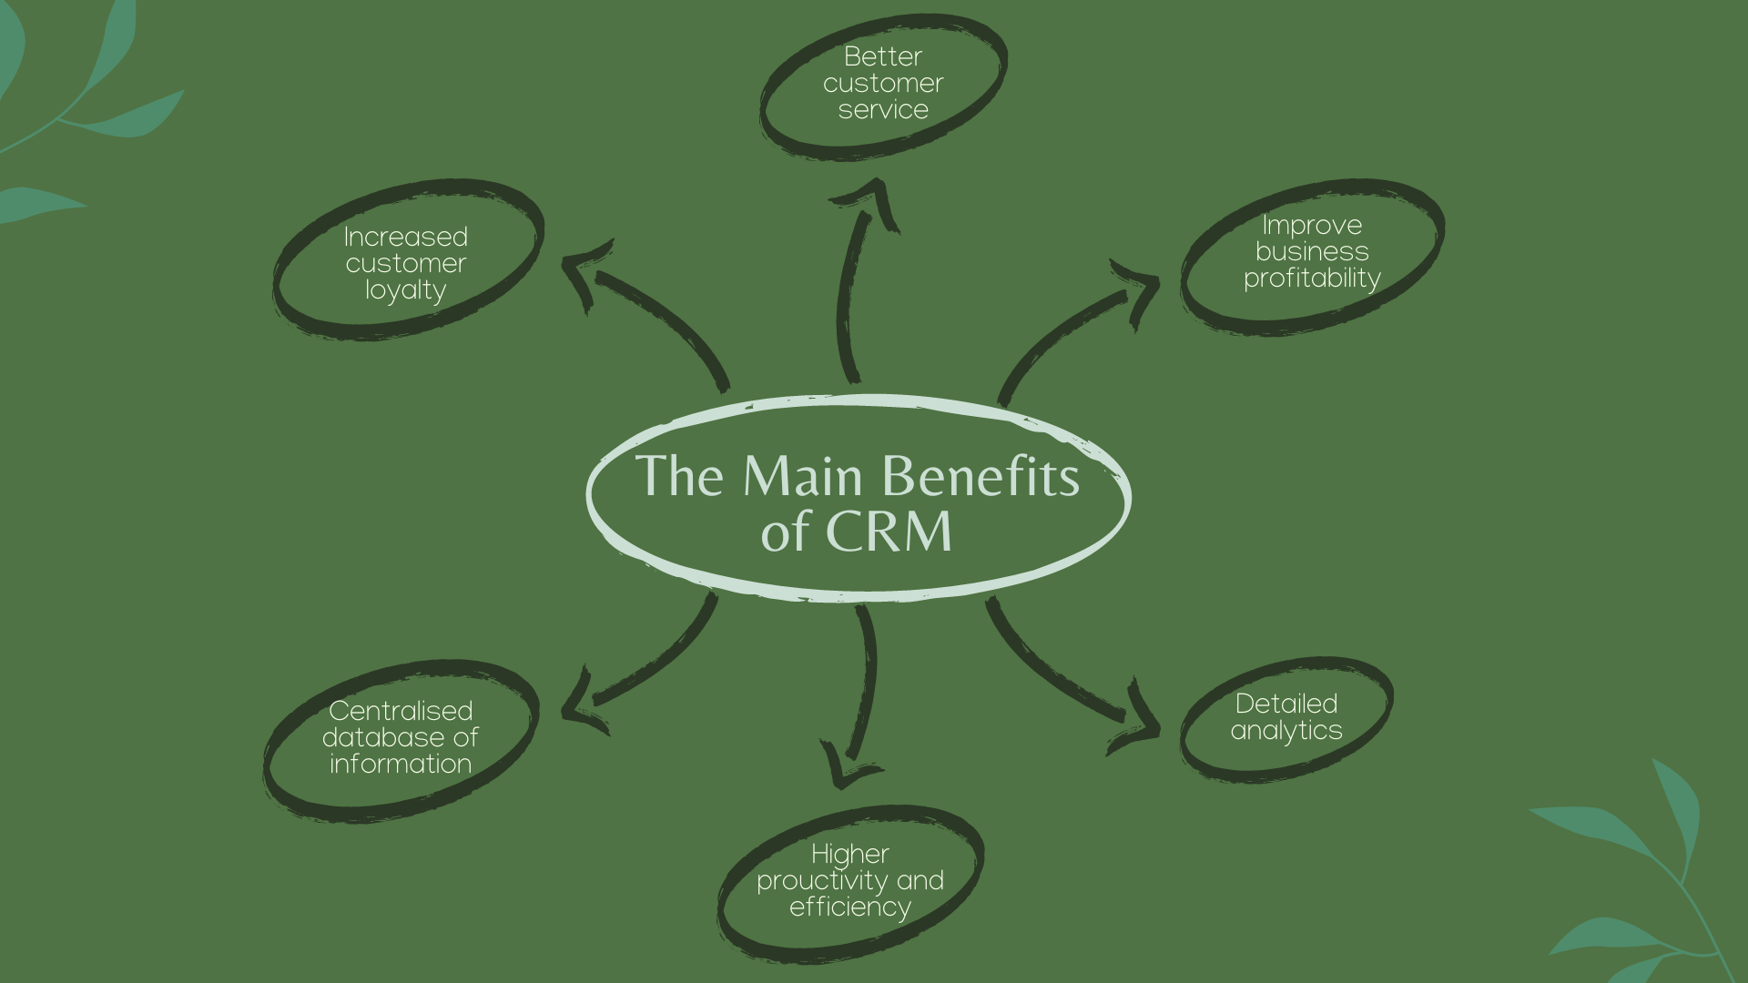

Slide 80
CRM and the Third Sector
The CRM system allows Third Sector Organisations to assume a form: foundation, society, association, self-help group, or federation.
The essence of NGOs is their functioning in terms of a specific structure, having formal entity, and at the same time staying independent from public authorities. These type of institutions are sovereign, which is tied with more responsibility.
By tying stakeholders to data, customer relationship management systems help non-profits expand their reach and create new opportunities.

Slide 81
The Benefits of a CRM System for Non-profits
Some CRM systems serve more specialized needs for certain types of organizations. Two common ones are:
Donor management systems: Used by charitable non-profits in particular, this system manages relationships with donors large and small and helps uncover long-term opportunities.

Slide 82
The Benefits of a CRM System for Non-profits
Common CRM systems (cont.):
Association management systems: While professional and trade associations may have a charitable component, their focus is different from many other types of non-profits. Their constituents are generally members, not customers, donors or beneficiaries.
An association management system is tailored to these needs and may also include website builders, tools for email marketing and event registration, and other components.

Slide 83
CRM for Charities: Steps To Success
IT implementation failure is an all too common story in the third sector. But how can smooth-running CRM implementation projects help charities avoid running into problems?
Before you start, do your research into CMR products
Choose the best solution for your situation
Deliver your solution into practice

Slide 84
Can CRM Be Applied in Smaller Charities?
A CRM system can be a truly useful and versatile toolkit that can help charities be more efficient and do far more with the data they collect.
A Survey (2019, Salesforce.org) showed that 58% of charities think CRM is exclusively for managing donors and beneficiaries, and only 26% of charities use CRM software.

Slide 85
CRM in Small Charities
Cost vs. benefit
Report on programme activities
Manage marketing communications
Manage online fundraising and other income streams
Manage volunteers

Slide 86
The Non-profit CRM Software
Non-profit organisations use CRM software that has been specifically designed to manage the relationship between non-profits and constituents (i.e., donors, volunteers, members).
Non-profit CRM software is mainly used by non-profit employees responsible for outreach, marketing, PR, or fundraising.
Managers use non-profit CRM to track the efficiency of their marketing efforts and to estimate the involvement of their members in various activities (events, fundraising, etc.).

Slide 87
Suggestions for Non-profit CRM Software
NetSuite
Bloomberang
EveryAction
Network for Good
Kindful
DonorPerfect

Slide 88
Suggestions for Non-profit CRM Software
To qualify for inclusion in the non-profit CRM category, a product must:
Provide features to create, manage and track marketing campaigns.
Include lead management functionality to prioritize marketing activities.
Deliver online portals for members and donors to create and manage profiles, make donations, or register for events.

Slide 89
Suggestions for Non-profit CRM Software
To qualify for inclusion in the non-profit CRM category, a product must (Cont.):
Facilitate communication with constituents using their preferred channels (i.e., email, phone, social media).
Manage constituents profile information as well as their contributions to activities or fundraising.

Slide 90
“No matter how brilliant your mind or strategy, if you’re playing a solo game, you’ll always lose out to a team.”
Reid Hoffman

Slide 91
Do You Need Help to Find Non-profit CRM Software?
Read a Guide (adaptaconsulting.co.uk, 2021) on suppliers and software packages that are capable to meet the key requirements for managing relationships with supporters, members, service users, beneficiaries and other types of contacts in the not-for-profit sector.
Join TechSoup for a Webinar with Maureen Wallbeoff, a non-profit digital strategist and technology coach, on “Selecting the Best Fundraising (CRM/Database) System”.

Slide 92
Collecting Data Ethically as a Charity
Collecting data is vital to helping charities improve, fundraise, and deliver services to beneficiaries.
Data can involve details to help charities’ fundraising and service delivery, through surveys and interviews as well as gathering personal information relating to people’s health and wellbeing.
People trust charities to look after their data and the sector has a duty to ensure the information is protected.

Slide 93
Collecting Data Ethically as a Charity
Here we look at some of the main pieces of advice for charities to ensure they are collecting their data ethically:
Know the law
Gain consent
Which data to keep or remove
How to ethically remove data
Communicating with people

Slide 94
Activity
Exercise:
Build a table of what your organisation needs in a CRM system, to obtain the most benefits.

Slide 95
Case Study
The Shelter Case Study - CRM system selection:
A Shelter approached Adapta to support them through the selection process for a replacement CRM system.
Their current system was not deemed sufficient for their fundraising ambitions and they had decided to look at a range of alternatives. They had previously attended some of Adapta’s seminars and decided to call for assistance.

Slide 96
Case Study
Automation Improving Volunteer Management:
Team Rubicon, is a non-profit disaster response group founded by former U.S. Marines 11 years ago, pulling off successful relief operations is an exercise in advanced data analytics.
That is because it has more than 138,000 volunteers supported by nearly 180 employees; it deployed more than 365 times last year alone.

Slide 97
Case Study
A Successful Application of a Customer Relationship Management Program in a non-profit Organization
Plan Notway is a non-profit organization which changed itself from being a sales-oriented company to a market-oriented one in the process of implementing a customer relationship management program.
The case of Plan Notway is examined using the five critical areas identified by researchers and practitioners-strategy, customers or market, people, process and technology.

Slide 98
Case Study
A Successful Application of a Customer Relationship Management Program in a non-profit Organization
The study identifies reasons for the success of the customer relationship management programs at the non-profit organization and offers insights to other organizations, both for non-profits and for profits.

Slide 99
Reflection Questions
What Does CRM Software Stand For?
What is CRM?
Who Can Benefit from CRM?
What are the benefits of CRM system?
How Does CRM Work?

Slide 100
Reflection Questions (Cont.)
What are the Types of CRM Systems?
How can CRM improve your business process?
What are examples of CRM processes in sales, marketing and service?
What are the Benefits of the CRM and BPM Synergy for Business?
Find answers here: https://www.successwithcrm.com/ultimate-crm-faqs

Slide 101
Learning Nuggets
Customer relationship management (CRM) can be defined as:
Efforts made towards creating, developing and maintaining a profitable relationship with customers using technology
A robust technological framework to organise all CRM data
A tool that boosts efficiency and productivity for large, global organizations
A quick and efficient management system that requires minimal employee training

Slide 102
Learning Nuggets
Customer relationship management (CRM) can be defined as:
Efforts made towards creating, developing and maintaining a profitable relationship with customers using technology
A robust technological framework to organise all CRM data
A tool that boosts efficiency and productivity for large, global organizations
A quick and efficient management system that requires minimal employee training
By integrating technology and management, CRM encompasses the use of software to assist in marketing, merchandising and selling to customers, as well as to assist in the developing and management of profitable relationships with customers.

Slide 103
Learning Nuggets
Select the main benefits of CRM from the list of characteristics below:
Better customer service |  | Improved business profitability
Better HR management |  | Sales force automation
Improved marketing |  | Higher productivity and efficiency
Detailed analytics |  | Increased customer loyalty
Centralised database |  | Better HR management

Slide 104
Learning Nuggets
Select the main benefits of CRM from the list of characteristics below:
Better customer service |  | Improved business profitability
Better HR management |  | Sales force automation
Improved marketing |  | Higher productivity and efficiency
Detailed analytics |  | Increased customer loyalty
Centralised database |  | Better HR management

Slide 105
Learning Nuggets
How is CRM not applied in small charities?
Management of online fundraising and other income streams
Segmenting donors based on their monetary contributions
Management of marketing communications
Reporting on programme activities

Slide 106
Learning Nuggets
How is CRM not applied in small charities?
Management of online fundraising and other income streams
Segmenting donors based on their monetary contributions
Management of marketing communications
Reporting on programme activities
In small charities, CRM should be used to define donors and members not only by their monetary contributions, but also by their in-kind, knowledge sharing or other relevant and valuable contributions.

Slide 107
Learning Nuggets
“The constituents of Association Management Systems are customers, donors and beneficiaries.” True or false?
True
False

Slide 108
Learning Nuggets
“The constituents of Association Management Systems are customers, donors and beneficiaries.” True or false?
True
False
Association Management Systems generally consist of members.

Slide 109
Learning Nuggets
List 3 different CRM software packages which are appropriate for non-profit organizations.

Slide 110
Learning Nuggets
Any 3 of the options below are correct:
NetSuite | EveryAction
Bloomberang | Kindful
Network for Good | DonorPerfect

Slide 111
03
Search Engine Optimization (SEO)

Slide 112
Search Engine Optimization (SEO) Overview
Definition: SEO (Search Engine Optimization) consists of the use of tools that serve to optimize web pages and position them in the lists of search engines, such as Google. Based on this, websites acquire their ranking.
SEO is not only used for search engines but also for users. It is essential that each page is relevant to the content and that it speaks clearly and concretely.
SEO is about being search-engine friendly, but it is about people, too.

Slide 113
SEO and the Third Sector
The goal is to get your site to rank as high as possible for target keywords or phrases relevant to your website. Doing so helps your content organically appear at the top of the search engine result pages (SERPs) for users who are curious about a certain topic.
For example, let us say we manage a food bank in New York City and are trying to improve our SEO by optimizing our website.

Slide 114
SEO and the Third Sector
The first page of the SERPs is a worthy goal, but if you are aiming high you might as well shoot for the top three positions.
A Sistrix study reported that the first organic result in Google Search has an average click-through rate (CTR) of 28.5%, with the second and third positions having a 15% and 11% CTR, respectively.
Clicks drastically drop for results carrying over to the second page with a CTR of less than 1%.

Slide 115
SEO and the Third Sector: How Does SEO Work?
Meaning of your query
Usability of web pages
Relevance of web pages
Context and settings
Quality of content

Slide 116
SEO and the Third Sector
Use the right target keywords
SEO Tools for non-profits

Slide 117
SEO and the Third Sector
Create quality content
Create focused content:
Keeping content up to date
Ensuring your content is factually accurate
Recruiting experts or guest writers to create content

Slide 118
SEO and the Third Sector
Create quality content (cont.)
Lean into YouTube
Elevate your content with visuals

Slide 119
SEO and the Third Sector
Follow on-page best practices
Title Tag
Meta Description
Headings

Slide 120
SEO and the Third Sector
Follow on-page best practices (cont.)
ALT Text
Internal Linking
Anchor Text

Slide 121
SEO and the Third Sector
Optimize your user experience
Keep website load time under 5 seconds to avoid losing readers’ attention
Offer intuitive navigation to show your audience where to get key information

Slide 122
SEO and the Third Sector
Optimize your user experience (cont.)
Make your content easy to read and understand
Organize your content to make it more easily discoverable
Meet the four principles for web accessibility

Slide 123
SEO and the Third Sector
Pay attention to off-page SEO
Leverage local SEO opportunities
Stay updated on SEO trends
Core Web Vitals: Google Core Web Vitals measure and evaluate the speed, responsiveness, and visual stability of your website.

Slide 124
SEO and the Third Sector
Stay updated on SEO trends (Cont.)
AMP: Accelerated Mobile Pages are now backed by Google as they help make mobile sites load instantaneously with minified code.
Structured data: Structured data is a way to mark-up the information on your pages to help google understand the various elements. This information can help improve your page’s SEO and keyword rankings.

Slide 125
SEO and the Third Sector
Stay updated on SEO trends (Cont.)
Https: Google has promised a ranking boost to secure sites that have adopted https and will even warn users of non-secure sites in their internet browser.

Slide 126
“Don’t be cocky. Don’t be flashy. There’s always someone better than you.”
Tony Hsieh

Slide 127
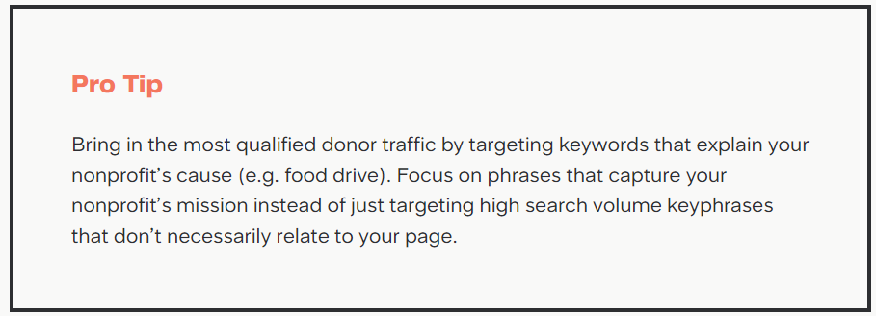
SEO and the Third Sector

Slide 128
SEO Best Practices
SEO best practices are a set of tasks designed to help improve a website’s search engine rankings. Common search engine optimization best practices include on-site optimization, researching keywords, and building backlinks to a site.
There are a million things you can do to get higher Google rankings, including advanced SEO strategies and techniques.

Slide 129
The Main Steps to Create an Effective SEO Strategy in 2022
Step 1: Create a list of keywords
Step 2: Analyse Google’s first page
Step 3: Create something different or better
Step 4: Add a hook
Step 5: Optimise for on-page SEO

Slide 130
The Main Steps to Create an Effective SEO Strategy in 2022 (Cont.)
Step 6: Optimise for search intent
Step 7: Focus on content design
Step 8: Build links to your page
Step 9: Improve and update your content

Slide 131
How to Measure SEO Performance and Results
Numbers is the first step in evaluating the performance of your SEO strategy.
There are hundreds of metrics you can track. Google uses over 200 ranking factors in its algorithm.

Slide 132
How to Measure SEO Performance and Results
Examples include:
Organic Traffic
Keyword Ranking
SERP Visibility
Click-through Rate
Bounce Rate
Website Authority over Time

Slide 133
How to Measure SEO Performance and Results
Examples (Cont.):
Backlinks
Page Speed
Time Spent on Page
Conversion Rate
How Long Does it Take to See SEO Results?

Slide 134
Activity - Tools
Answer The Public
Woorank’s SEO & Website Analysis Tool
Animalz Revive
CanIRank
Google’s Mobile-Friendly Test
25 Best Free SEO Tools (2022):

Slide 135
Activity - Tools
Seed Keywords
Exploding Topics
Seobility
Ubersuggest
BROWSEO
25 Best Free SEO Tools (2022) (Cont.):

Slide 136
Activity - Tools
Detailed.com
Google Search Console
SERPerator
Screaming Frog
Google Analytics
25 Best Free SEO Tools (2022)(Cont.):

Slide 137
Activity - Tools
Reddit Keyword Research Tool
Yoast WordPress Plugin
Panguin Tool
Wordtracker Scout
Lipperhey
25 Best Free SEO Tools (2022)(Cont.):

Slide 138
Activity - Tools
Bing Webmaster Tools
Dareboost
Siteliner
KWFinder
People Also Ask
25 Best Free SEO Tools (2022)(Cont.):

Slide 139
Activity - Tools
25 Best Free SEO Tools (2022)(Cont.):
Source: https://backlinko.com/best-free-seo-tools
Bonus #1. Bulk Google Rank Checker
Bonus #2. LSI Graph

Slide 140
Activity - Tools
Exercise 1:
Use any of the many free SEO checkers to see how the website of your organisation rates, and suggest some improvements.
Tip: How does an SEO checker work?
The Seobility SEO checker crawls the URL you enter, similar to how search engines work.

Slide 141
Activity - Tools
Tip: How does an SEO checker work (Cont.)?
The page is then checked against more than 200 SEO relevant criteria: meta information, page quality, site structure, and others.
Based on how well your website performs regarding these criteria, an individual SEO score is calculated and shown together with a complete list of errors found on your site.

Slide 142
Case Study
The Power of Modern SEO Content: A Non-Profit Case Study
This example focuses on organic traffic and how this was translated into economic and sustainable growth for the organisation.

Slide 143
Case Study
The case of Texas Adoption Center and LOCAL SEO
Texas Adoption Center is a non-profit organisation in Round Rock, Texas. One of the main challenges it faced was how to compete online with the rest of the market.
The solution was provided by a Local SEO campaign which help Texas Adoption Center to develop optimised landing pages and blog posts targeting local keywords.

Slide 144
Case Study
The non-profit Search Engine Optimization Case Study
SEO Design Chicago helped a national non-profit agency by providing them with a new WordPress website along with SEO services.
We also aided them with unique, newly created content in order to promote their projects and opportunities.

Slide 145
Reflection Questions
What is SEO?
Does my business need SEO?
How does SEO work?
How can I find the keywords that people are searching for to find businesses like mine?

Slide 146
Reflection Questions (Cont.)
Why is my website ranking not on google?
Why has my organic traffic dropped?
What is a google penalty?
How long does it take to rank on google?

Slide 147
Reflection Questions (Cont.)
What are Google's most important ranking factors?
Should I do SEO, run PPC Ads, or both?
Does social media help to increase my website's rank?

Slide 148
Additional Technical Questions
What is the difference between on-page SEO and technical SEO?
How can I find Technical SEO errors?

Slide 149
Content Marketing Questions
How long should a page of content be?
How do I create SEO-friendly content?
Does duplicate content harm your website's rankings?

Slide 150
Link Building Questions
What is link building?
How do I get other sites to link to mine?
Should I focus on getting more links?
Is it true that I can buy links?

Slide 151
Link Building Questions
What is PageRank?
How do I analyse my competitor's link profile?

Slide 152
Learning Nuggets
“Search engine optimization (SEO) consists of tools the optimize web pages so that they can be more clearly positioned in the list of results.” True or false?
True
False

Slide 153
Learning Nuggets
“Search engine optimization (SEO) consists of tools the optimize web pages so that they can be more clearly positioned in the list of results.” True or false?
True
False

Slide 154
Learning Nuggets
Which of the following is not a component of SEO?
Meaning of your enquiry
Usability of web pages
Domain extensions
Context and settings

Slide 155
Learning Nuggets
Which of the following is not a component of SEO?
Meaning of your enquiry
Usability of web pages
Domain extensions
Context and settings
Most internet users are familiar with .com website extensions and possibly, will not click on .biz or other generic domain names. However, if a website has a geographically characterised domain name, such as .uk, and most of the end-users are located in the UK, the website may get more search traffic than a website with a globally recognised domain extension such as .com.

Slide 156
Learning Nuggets
Put the following steps of creating an effective SEO strategy in the correct order:
Create something different or better | Optimize for search intent
Add a hook | Improve and update your content
Create a list of key words | Optimize for on-page SEO
Analyse Google’s first page | Build links to your page
Focus on content design

Slide 157
Learning Nuggets
Answer:
1. Create your list of keywords
4. Add a hook
5. Optimize for on-page SEO
6. Optimize for search intent
7. Focus on content design
8. Build links to your page
9. Improve and update your content
2. Analyse Google’s first page
3. Create something different or better

Slide 158
Learning Nuggets
Select the relevant performance indicators which are used to monitor SEO results:
Organic traffic |  | Average resolution time
Net Promoter Score |  | Social media engagement
Conversion rate |  | Backlinks
Abandonment rate |  | First response time
Keyword rating |  | Click-through rate
Backlogs |  | Cost Performance index

Slide 159
Learning Nuggets
Select the relevant performance indicators which are used to monitor SEO results:
Organic traffic |  | Average resolution time
Net Promoter Score |  | Social media engagement
Conversion rate |  | Backlinks
Abandonment rate |  | First response time
Keyword rating |  | Click-through rate
Backlogs |  | Cost Performance index

Slide 160
Learning Nuggets
List 5 examples of effective, free online SEO tools.

Slide 161
Learning Nuggets
Any 5 of the options below are correct:
Answer The Public | Exploding Topics | Google Search Console | Wordtracker Scout | People Also Ask
Woorank’s SEO & Website Analysis Tool | Seobility | SERPerator | Panguin Tool | KWFinder
Animalz Revive | Ubersuggest | Screaming Frog | Yoast WordPress Plugin | Bonus #1. Bulk Google Rank Checker
CanIRank | BROWSEO | Google Analytics | Bing Webmaster Tools | Bonus #2. LSI Graph
Google’s Mobile-Friendly Test | Detailed.com | Reddit Keyword Research Tool | Dareboost
Seed Keywords | Lipperhey | Siteliner | People Also Ask

Slide 162
04
Cloud

Slide 163
Cloud: Learn How to Manage the Use of Cloud Computing Effectively
Cloud management refers to the exercise of control over public, private and hybrid cloud infrastructure resources and services.
Successful Cloud computer management can increase a company’s performance, reliability, cost containment and environmental sustainability.

Slide 164
Cloud Management Tasks
The Cloud provider performs a number of tasks to ensure sufficient use of cloud resources:
Audit systems back-up
Data flow of the system
Vendor lock-in Awareness and solutions
Knowing provider’s security procedures

Slide 165
Cloud Management Tasks
The Cloud provider performs a number of tasks to ensure sufficient use of cloud resources (Cont.):
Monitoring capacity planning and scaling capabilities
Monitor audit log use
Solution testing and validation

Slide 166
Cloud Management vs. Cloud Computing
Cloud management is not cloud computing; Clouds are pools of virtual resources, storage, applications, services that are managed by a software so that the resources can be accessed on demand.
Cloud computing is the act of running workloads within clouds—which are IT environments that abstract, pool, and share scalable resources across a network.

Slide 167
Cloud Management vs. Cloud Computing
Cloud management is a combination of software, automation, policies, governance, and people that determine how those cloud computing services are made available.

Slide 168
The Role of a Cloud Management Platform
Integrate with existing IT
Automate manual tasks
Visualise costs
Be accessible through the internet
Support hybrid Cloud and multi-Cloud environments

Slide 169
What Is Cloud Computing?
Cloud computing is a form of computing in which networks, data storage, applications, security and development tools are all enabled via the Internet, as opposed to a local computer or an on-premise server in your organization.
The field of cloud computing has been growing rapidly for years, as more companies seek to work remotely, boost efficiency through automation and save money on IT infrastructure.

Slide 170
What Is Cloud Computing?
According to a 2021 report from Gartner, global end-user spending on public cloud services is projected to grow 23.1% in 2021 to $332.3 billion – up from $270 billion.

Slide 171
Types of Cloud Computing
Infrastructure as a Service (IaaS)
Platform as a Service (PaaS)
Software as a Service (SaaS)

Slide 172
Cloud Management Tasks
Simple steps to get you started:
Office 365 Email Pilot Migration
Use Microsoft Outlook
Multi-Factor Authentication (MFA) Jumpstart

Slide 173
Cloud Management Tasks
Simple steps to get you started (Cont.):
Advanced Threat Protection (ATP)
Use of Dropbox and/or OneDrive
Keep track of your donor with the use of a CRM (i.e., Salesforce or Dynamics 365

Slide 174
Cloud Computing and the Third Sector
You can get started with the following:
Office 365 Email Pilot Migration
Multi-Factor Authentication (MFA) Jumpstart
Advanced Threat Protection (ATP)

Slide 175
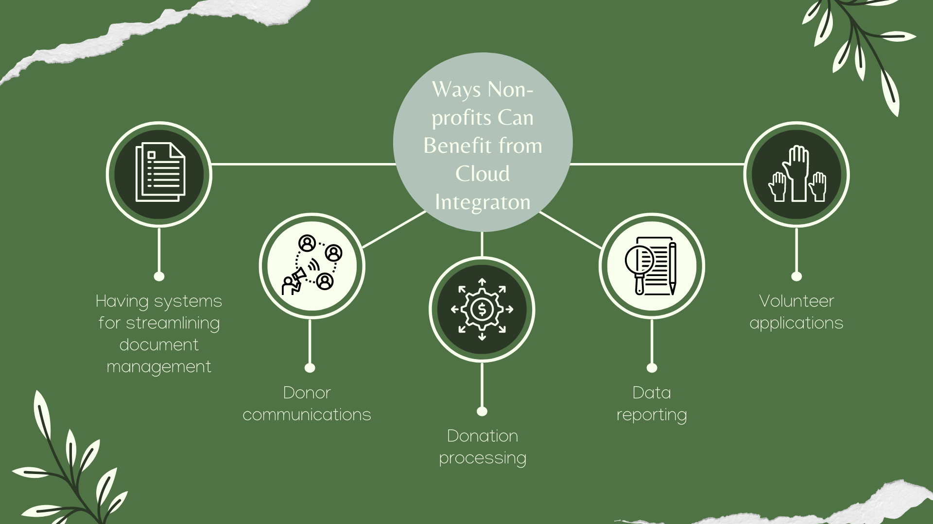

Slide 176
Six Ways Cloud-based Technology Can Transform Non-profit Organizations
Rapid response and innovation
Cost-effectiveness
Efficient scalability
Mobile and virtual capabilities
Notes:
Read more at: https://www.rklcpa.com/six-ways-cloud-based-technology-can-transform-non-profit-organizations/

Slide 177
Six Ways Cloud-based Technology Can Transform Non-profit Organizations
Access to big data
Silo-breaking integrations
Notes:
Read more at: https://www.rklcpa.com/six-ways-cloud-based-technology-can-transform-non-profit-organizations/

Slide 178
“Live each day as if your life had just begun.”
Johann Wolfgang Von Goethe

Slide 179
Google Services for Third Sector Organisations
Google for Non-profits is something you can get in more than 50 countries, although the exact product you can get varies based on the country.
The first step is to see if your non-profit is eligible for the Google for non-profits program. (i.e., if you have an educational organisation, it might be better to use Google for Education).

Slide 180
Google Services for Third Sector Organisations
Google’s YouTube: You can submit your non-profit videos right through YouTube to get help connecting with those promoting your program.
This program allows you to put up special cards called “Link Anywhere” cards to enable you to send visitors directly to your non-profit site.
Google Ad Grants: This option can help you to reach people all over the globe with your organization’s message.

Slide 181
Google Services for Third Sector Organisations
Google Ad Grants (Cont.):
If you qualify, you will end up with an ad budget handled by a grant which makes it so that you can grow and find more people to support you without having to draw on your own money and internal resources overmuch.

Slide 182
The Benefits of Multi-Cloud for Non-profits
The cost, security and agility benefits of working across multiple clouds can give non-profits an edge — but only if they implement it effectively.
Why non-profits May Find Multi-Cloud a Good Fit: non-profits may be familiar with managing data using the hybrid cloud, which separates data on a public cloud from data managed through an onsite data centre.

Slide 183
The Benefits of Multi-Cloud for Non-profits
Multi-Cloud Considerations for non-profits: While a multi-cloud approach can be seen potentially as a cost saver, it also can create significant complexities for organizations if not managed properly.
How to Manage Multi-Cloud Environments: The challenges of a multi-Cloud environment can be a lot for a non-profit organization to manage, but much of what will make multi-Cloud work for your non-profit comes down to the approach.

Slide 184
The Benefits of Multi-Cloud for Non-profits
In 2020, Cloud services took centre stage as the entire world shifted to working remotely. The term Cloud services encompasses many different types of technology, platforms and applications.
Simply put, cloud computing is the delivery of IT services via the internet. Moving to a Cloud based IT solution therefore means moving away from a traditional on-premises server.

Slide 185
The Benefits of Multi-Cloud for Non-profits
Regardless of whether your organisation is a non-profit, small business, or global enterprise there are some common benefits of Cloud based IT solutions. These include:
Security
Collaboration
Accessibility
Cost efficiency

Slide 186
The Benefits of Multi-Cloud for Non-profits
The element of unknown around Cloud services for non-profits is often the biggest barrier to organisations embracing the change.

Slide 187
Set up and Configure Microsoft Cloud for Non-profit
Microsoft Cloud for non-profit includes solutions that are built on capabilities within Microsoft Dynamics 365, Microsoft Power Platform, Microsoft 365, Microsoft Azure, and LinkedIn.
You deploy these solutions in Microsoft Cloud Solution Center, which provides a central place to deploy industry cloud solutions from Microsoft, including solutions that are part of Microsoft Cloud for non-profit.

Slide 188
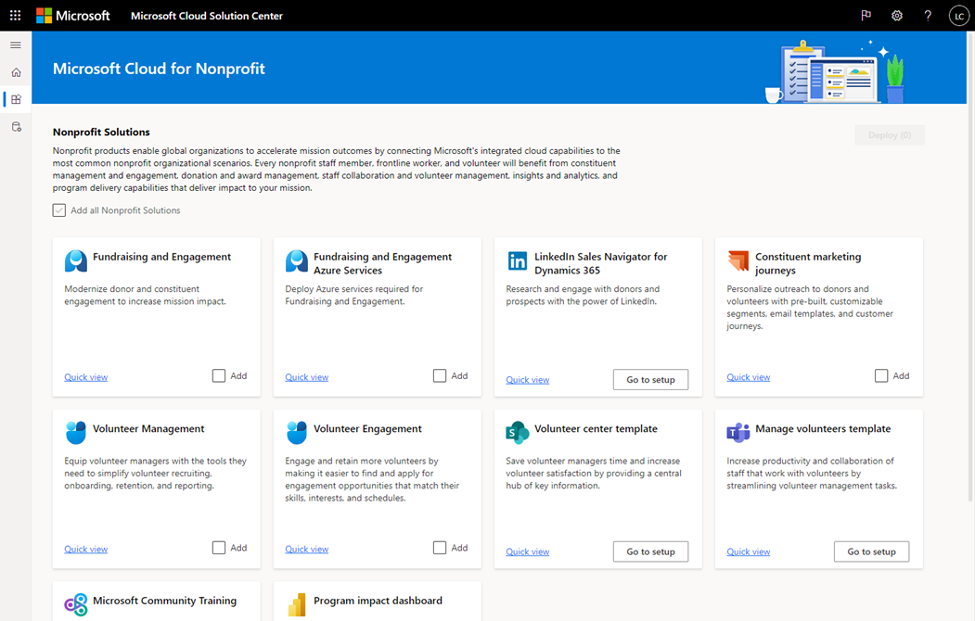

Slide 189
Moving to Cloud Computing for Non-profits
Implications of Moving to the Cloud:
Although signing up for cloud services can be a fairly simple process, transitioning an organization’s operations to the cloud is rarely straightforward.
Just as choosing traditional software and services requires a deliberative process, moving to the cloud and expanding the use of SaaS also requires a tech strategy and plan.

Slide 190
Moving to Cloud Computing for Non-profits
Doing the Work to Move
As with any IT transformation project, moving to the cloud requires a significant amount of planning and consideration.
Regardless of whether moving existing data and applications to the cloud or deploying new data and applications to the cloud, an organization must begin by assessing its current infrastructure and needs, selecting the cloud option(s), and structuring the organization‘s data.

Slide 191
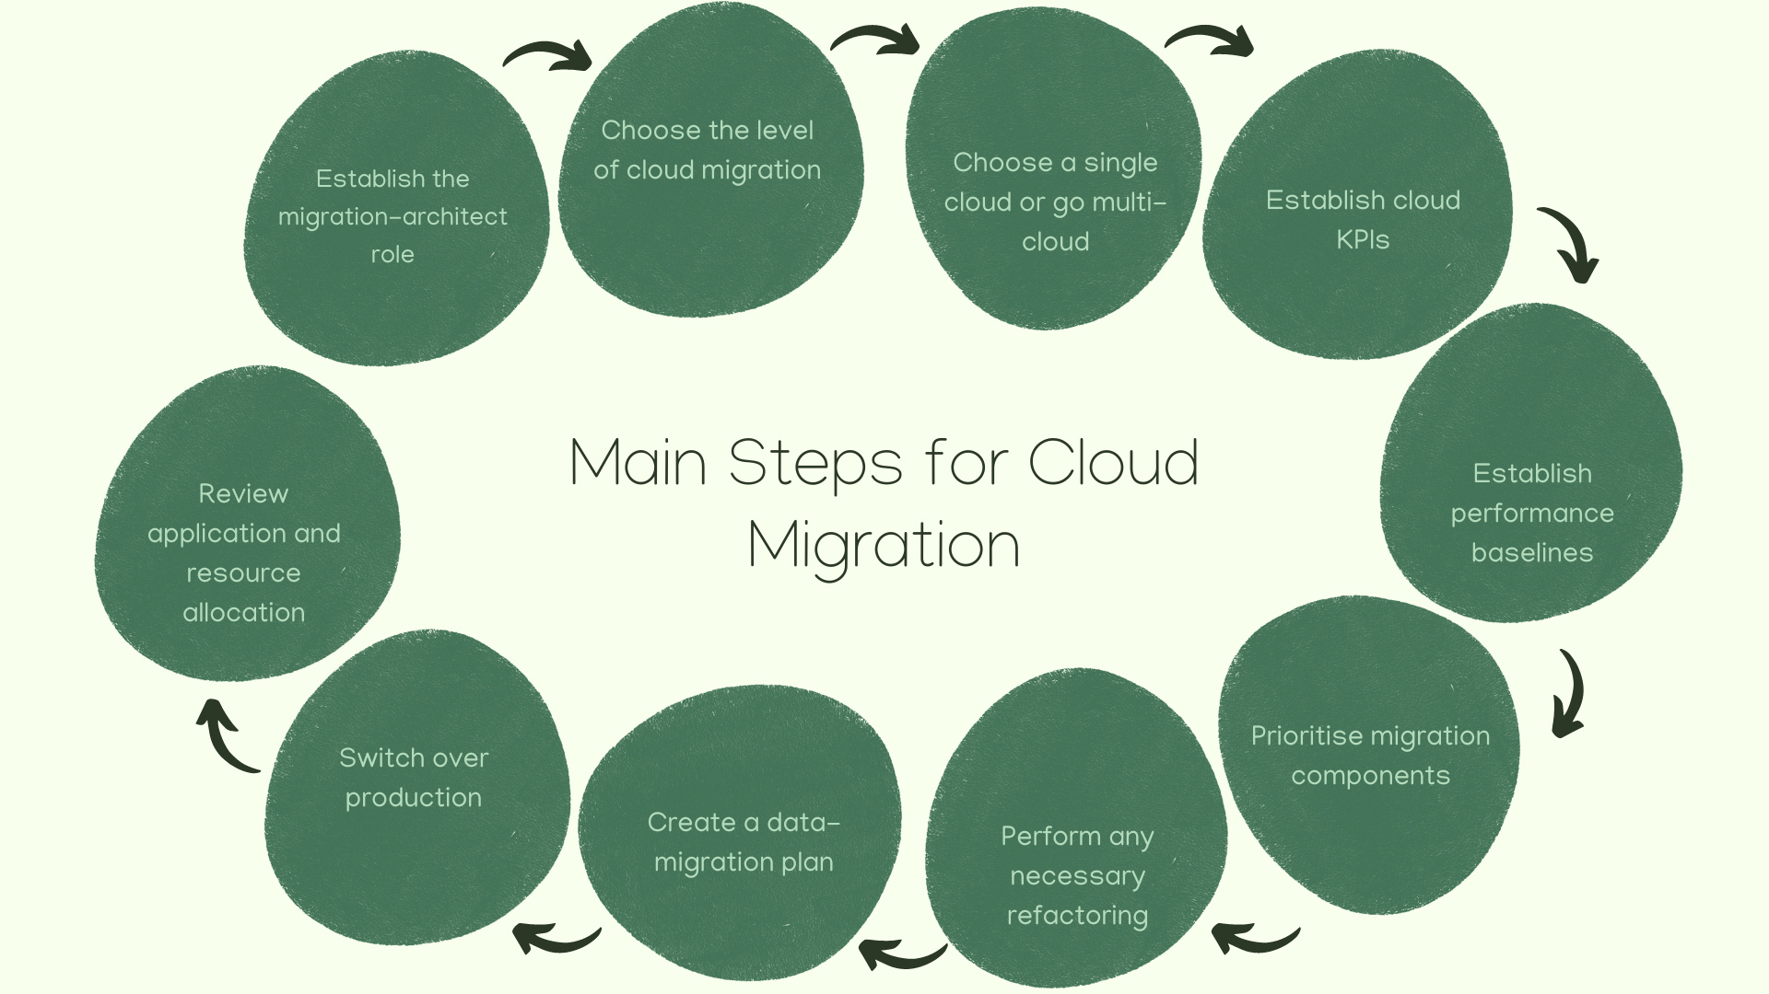
Notes:
Read more about each step at: https://newrelic.com/blog/best-practices/cloud-migration-checklist

Slide 192
“Success is the sum of small efforts – repeated day in and day out.”
Robert Collier

Slide 193
Amazon Web Services (AWS) for Third Sector Organisations
Amazon Web Services (AWS) is dedicated to a world where every person has the opportunity to live a life of dignity on a healthy planet. Tens of thousands of non-profits and non-governmental organizations worldwide use AWS to increase their impact and advance mission goals.
Whether you are working to improve the performance of donor-facing websites, enhancing data practices through managed databases and analytics, propelling research through machine learning, or improving remote monitoring with the Internet of Things (IoT), AWS is here to help.

Slide 194
The ‘Work-from-Everywhere’ Model
The pandemic has accelerated trends toward a work-from-anywhere model.
While businesses accommodate remote workers, they also must adjust onsite workflows to new realities.
IT decision-making must involve more stakeholders in a hybrid work environment.

Slide 195
The ‘Work-from-Everywhere’ Model
To find out more you can watch a webcast with:
Jorge Perez, Vice President, North America Client Solutions Group, Dell Technologies
Josh Benson, IT Manager, North Valley Health Center
Quinn Chapman, Account Manager, Healthcare, CDW•G
Keara Dowd, Editor, BizTech; Host, CDW Tech Talk Series

Slide 196
Strategic Planning for Non-profits
A strategic planning process identifies strategies that will best enable a non-profit to advance its mission. Many non-profits start the process by identifying the non-profit’s strengths, weaknesses, opportunities, and threats, in what is commonly called a “SWOT” analysis.
Tip: Looking at external as well as internal factors (such as your own non-profit's staff capacity to accomplish its goals) is also very important.

Slide 197
Strategic Planning for Non-profits
Practice Pointers:
A good way to keep your non-profit’s board engaged is to tie the non-profit's strategic initiatives to the agenda for board meetings, and to include a short discussion about some part of the non-profit’s strategic directions in every board meeting agenda.
Questions to ask include: "Is that strategic initiative still relevant?” and, "Are the priorities (or tactics) we identified earlier the correct ones for the near future?"

Slide 198
Strategic Planning for Non-profits
Tools
Sample strategic agenda for a board meeting
Sample Timeline for Strategic Planning (Washington non-profits)
Create a strategic plan for your non-profit (NOLO)

Slide 199
Strategic Planning for Non-profits
Resources
The Strategic Plan is Dead: Long Live Strategy (Stanford Social Innovation Review)
The non-profit Strategy Revolution: Real-Time Strategic Planning in a Rapid-Response World (David La Piana)
What’s the difference between a business plan and a strategic plan for a non-profit?

Slide 200
The Challenges Faced by Non-profit Managers
Financial feasibility: since non-profits do not directly generate revenue, staying sustainable is a number-one worry for organization managers.
Recruitment and talent retention: it is hard to attract and keep skilled teammates onboard. As a result, in the non-profit world, having responsibilities outside your job description is “the new normal”.

Slide 201
The Challenges Faced by Non-profit Managers
Lack of organization management tools: few organizations have a technological infrastructure robust enough to fully support the team’s efforts.
Legitimacy: there is a lot of scepticism around charity these days. Many point to The New York Time’s 2012 coverage of a story on fake orphanages in Haiti. Such scandals make it harder for non-profit managers to engage supporters.

Slide 202
Building a Tech Strategy for Non-profits
Be clear about your goals
Define your target audience
Build a powerful infrastructure
Choose the right tool
Monitor success

Slide 203
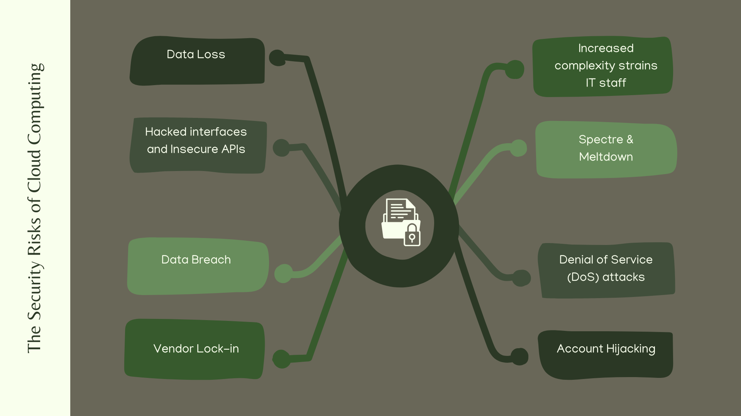

Slide 204
Cloud Basics for Non-profits and Libraries
In 2012, a survey by TechSoup concluded that the biggest barrier for the adaptation of Cloud services for NGOs is the lack of knowledge.
When TechSoup surveyed NGOs, non-profits, and charities around the world in 2012, we found that lack of knowledge was the biggest barrier to adopting cloud services.

Slide 205
Activity
Activity 1 – “Make-a-Map”:
Make a concept map identifying the benefits and drawbacks of using and storing data from the cloud.

Slide 206
Case Study
The Application Suite Migration Case:
A non-profit organization set out to modernize the application suite with server-less computing and other innovations found in Azure’s Platform as a Service (PaaS) offerings.
BrainScale upgraded the non-profit organization’s infrastructure to refactor from IAAS web–application to an Azure PaaS APP service.

Slide 207
Case Study
How AWS Is Used To Move A Non-Profit Organization’s Server To Cloud:
The first step undertaken by D.A.R.E. in order to migrate their server to Cloud was to understand the existing obstacles from inside-out.
In this case study, you will see how we analysed the challenges faced by the client.

Slide 208
Case Study
The Cambodian Children's Fund Case:
The Cambodian Children’s Fund was outgrowing its existing financial software. They were always running three weeks behind on their financials and this led to wasted resources and poor reporting/metrics.
Thus, the Cambodian Children’s Fund needed a cloud-based accounting solution.

Slide 209
Reflection Questions
What is cloud computing?
Is Cloud computing the same as software-as-a-service?
What types of services are available via the cloud computing model?
What types of applications can run in the Cloud?

Slide 210
Reflection Questions (Cont.)
Will my organisation need to hire more IT staff to handle the transition to cloud computing?
What are the benefits of cloud computing?
What are the risks of cloud computing?
Is the Cloud secure?

Slide 211
Learning Nuggets
Cloud management can be defined as:
A form of computing in which software tools are enabled via the internet
The combination of software, automation, policies and governance that determine the type of cloud services available
A form of computing that you can get in more than 50 countries
Hybrid computing applications within Microsoft software systems

Slide 212
Learning Nuggets
Cloud management can be defined as:
A form of computing in which software tools are enabled via the internet
The combination of software, automation, policies and governance that determine the type of cloud services available
A form of computing that you can get in more than 50 countries
Hybrid computing applications within Microsoft software systems
Cloud management is about the exercise of control over public, private and hybrid cloud infrastructure resources and services.

Slide 213
Learning Nuggets
A cloud resource that is not made available by and IaaS cloud provider would be:
Audit systems back-up
Vendor lock-in awareness and solutions
Capacity planning and scaling capabilities planning
Application security

Slide 214
Learning Nuggets
A cloud resource that is not made available by and IaaS cloud provider would be:
Audit systems back-up
Vendor lock-in awareness and solutions
Capacity planning and scaling capabilities planning
Application security
As a minimum, the IaaS (Infrastructure as a Service) cloud provider is responsible for protecting the infrastructure that runs all the services offered in the cloud. However, the organisation is solely responsible for the operating system and application security including controls to ensure data privacy, protection and encryption.

Slide 215
Learning Nuggets
“Donation processing is a way that non-profits can benefit from cloud integration.” True or false?
True
False

Slide 216
Learning Nuggets
“Donation processing is a way that non-profits can benefit from cloud integration.” True or false?
True
False

Slide 217
Learning Nuggets
List 4 ways that cloud-based technology can transform non-profit organizations

Slide 218
Learning Nuggets
Any 4 of the options below are correct:
Rapid response and innovation | Mobile and virtual capabilities
Cost-effectiveness | Access to big data
Efficient scalability | Silo-breaking integrations

Slide 219
Learning Nuggets
Match the following Google services for Third Sector Organizations with their correct descriptions:
Google for Non-profits
This programme allows the organization to set up special online linking cards which send visitors directly to the organization’s website.
Google’s YouTube
This service helps the organization reach people all over the world with the organization’s global message.
Google Ad Grants
The exact service varies based on location. The organization needs to check their eligibility for this service.

Slide 220
Learning Nuggets
Match the following Google services for Third Sector Organizations with their correct descriptions:
Google for Non-profits
This programme allows the organization to set up special online linking cards which send visitors directly to the organization’s website.
Google’s YouTube
This service helps the organization reach people all over the world with the organization’s global message.
Google Ad Grants
The exact service varies based on location. The organization needs to check their eligibility for this service.

Slide 221
05
Agile Methodologies

Slide 222
Agile Methodologies
The Agile methodology is a simple, iterative way to turn an idea with a bunch of requirements into a software solution.
It uses constant planning, understanding, updating, communication, development and delivery as part of an agile process that gets fragmented into separate models.
Notes:
Source: https://jexo.io/blog/everything-you-need-to-know-about-agile-methodologies/

Slide 223
What Is Agile Software?
Agile software development refers to a group of software development methodologies based on iterative development, where requirements and solutions advance through collaboration between self-organizing cross-functional teams.
Agile methods or Agile processes generally promote a disciplined project management process that encourages frequent inspection and adaptation, teamwork, self-organization and accountability.

Slide 224
What Is Agile Software?
Agile development refers to any development process that is aligned with the concepts of the Agile Manifesto.
The Manifesto was developed by a group of fourteen leading figures in the software industry, and reflects their experience of what approaches do and do not work for software development. Read more about the Agile Manifesto.
Did you know that Agile can also be applied to hardware projects? Learn about Prime Agile for Hardware framework.

Slide 225
What is Agile Software?
What Is Scrum?
Scrum is a subset of Agile. It is a lightweight process framework for agile development, and the most widely-used one.
A “process framework” is a particular set of practices that must be followed in order for a process to be consistent with the framework.
(For example, the Scrum process framework requires the use of development cycles called Sprints, the XP framework requires pair programming, and so forth.)

Slide 226
What is Agile Software?
“Lightweight” means that the overhead of the process is kept as small as possible, to maximize the amount of productive time available for getting useful work done.
What are the benefits of Agile?
What are the Scrum requirements?
What are the Scrum roles?
How does Agile save you money?

Slide 227
The Agile Methodologies
There are over 50 agile methods for project managers to improve structure in the way they deliver projects. Some examples are:
Scrum
Kanban
Scrumban
Lean Development

Slide 229
Building an Agile Non-Profit Organisation
Agile organisations cope better
Your operating model is the key factor for continued impact
Think and analyse global, decide local
Preparation-over-planning
Trust the data
Notes:
Read more at: https://mzninternational.com/2020/09/10/5-lessons-for-building-an-agile-non-profit-organisation/

Slide 230
How to Be Agile in a Non-profit Organization?
Is agile only for software projects?
Of course, it is not. Agile has become very popular in the last few years and many non-IT organizations are agile.
Questions to consider:
What is the meaning of “agile”?
Why it became so trendy?

Slide 231
How to Be Agile in a Non-profit Organization?
Think about your main long-term goals and how to achieve them.
Designate smaller goals and triumphs which will motivate your team to take action.
Focus only on the one most important thing and task, because smaller goals have to bring you closer to the main. So everything you will do has to be linked and have common features.
It should be a simple and ambitious plan with a good chance of success.

Slide 232
The Agile Principles
Individuals and interactions over processes and tools
Working software over comprehensive documentation
Customer collaboration over contract negotiation
Responding to change over following a plan

Slide 233
Tips for Non-profit Organization
Organise your work in 1 or 2 weeks “Sprints”. Remember to take it easy and enjoy it. You do not need to hurry up.
Being able to change and adapt to a new situation can be a non-profit’s biggest stronger and power.

Slide 234
Tips for Non-profit Organization
Agile help you organize your work, prioritize tasks, introduce measurability, responsibility and clear rules:
Limit your workday
Launch clear rules
Look through the lens of another person

Slide 235
“If you don’t like something, change it. If you can’t change it, change the way you think about it.”
Mary Engelbreit

Slide 236
Scrum Beyond Software: How Local NGOs Inspire Human Values and Principles
Human interactions provide fertile soil for modern, dynamic approaches like Scrum and other means, to bring agility into our environment.
We can very well rediscover the foundations of human interactions as they have been around for nearly as long as humanity itself — they were not just born in the context of advanced project management.

Slide 237
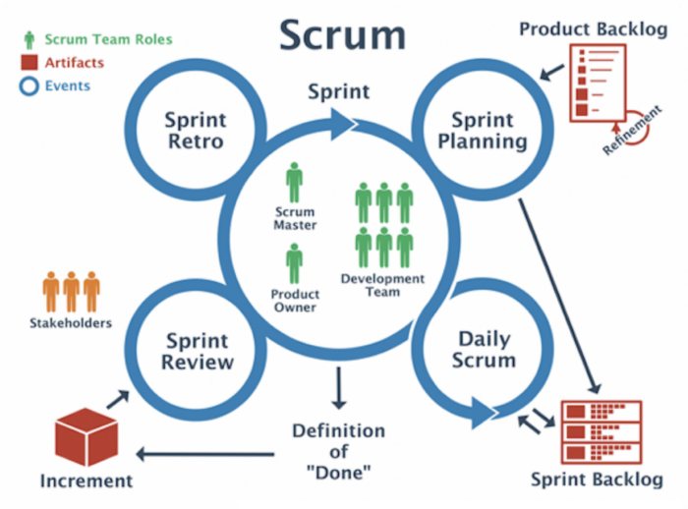

Slide 238
Scrum Beyond Software: How Local NGOs Inspire Human Values and Principles
This way of working, which is different from so many Western NGOs dedicated to “social development”, also incorporates some of the most important Agile principles:
Customer satisfaction by early and continuous delivery of valuable software
Welcome changing requirements, even in late stages of development
Deliver working software frequently (weeks rather than months)

Slide 239
Scrum Beyond Software: How Local NGOs Inspire Human Values and Principles
Important Agile principles (Cont.):
Close, daily cooperation between business people and developers
Projects are built around motivated individuals, who should be trusted
Face-to-face conversation is the best form of communication (co-location)
Working software is the primary measure of progress

Slide 240
Scrum Beyond Software: How Local NGOs Inspire Human Values and Principles
Important Agile principles (Cont.):
Sustainable development, able to maintain a constant pace
Continuous attention to technical excellence and good design
Simplicity — the art of maximizing the amount of work not done — is essential
Best architectures, requirements, and designs emerge from self-organizing teams

Slide 241
Scrum Beyond Software: How Local NGOs Inspire Human Values and Principles
Important Agile principles (Cont.):
Regularly, the team reflects on how to become more effective, and adjusts accordingly:
Individuals and Interactions over processes and tools
Working Software over comprehensive documentation

Slide 242
Scrum Beyond Software: How Local NGOs Inspire Human Values and Principles
Important Agile principles (Cont.):
Regularly, the team reflects on how to become more effective, and adjusts accordingly (Cont.):
Customer Collaboration over contract negotiation
Responding to Change over following a plan

Slide 243
The Future NGO Is Agile – a Webinar to Explore How Organizations Become More Agile

Slide 244
Agile Services for Non-profit Organizations
No matter what the cause, all companies and non-profits can benefit from faster product delivery, a team that can adapt to changes and balanced communication between all stakeholders.
Agile Services can help you create cross-functional teams which is very valuable when working with limited resources and manage decision making with agile principles across your team members.

Slide 245
The Main Benefits of Agile Methodology
Agile today stands as one of the most popular approaches to project management because of its flexible and progressive nature:
Superior quality product
Better control
Improved project predictability
Customer satisfaction
Reduced risks
Notes:
Read more at: https://kissflow.com/project/agile/benefits-of-agile/

Slide 246
The Main Benefits of Agile Methodology
Benefits (cont.):
Increased flexibility
Continuous improvement
Improved team morale
More relevant metrics
Notes:
Read more at: https://kissflow.com/project/agile/benefits-of-agile/

Slide 247
Essential Agile Practices for Non-profit Organizations
Ask for Team Input
Listen to Membership Base and Community
Make Space for Necessary Conversations
Embrace 'Creative Destruction'
Actively Listen to Your Patrons

Slide 248
Essential Agile Practices for Non-profit Organizations (Cont.)
Get Rid of Ineffective Leadership Structures
Foster Open Communication
Review Your Communication Process
Have a Clear Sense of Why You Exist
Embrace New Ideas to Create Opportunity

Slide 249
Essential Agile Practices for Non-profit Organizations (Cont.)
Start Each Day with Quiet Time
Share Stories to Encourage Collaboration
Conduct after-action Reviews
Be a Teachable Leader, Promote Learning

Slide 250
“The pessimist sees difficulty in every opportunity. The optimist sees opportunity in every difficulty.”
Winston Churchill

Slide 251
Goal-Driven Project Management: Adapting Agile Methodology to Non-Software Projects
There are many measures of success, such as achieving a goal, modifying a behaviour, or sustaining a change. As critical as success is for any organization, defining it is often easier than attaining it.
With many professionals certified in IT Agile project management, P&N’s multidisciplinary consulting team decided to investigate first-hand how this method could be applied beyond software development.

Slide 252
Goal-Driven Project Management: Adapting Agile Methodology to Non-Software Projects
Incremental goals: The planning is broken down into smaller, incremental goals. For many organizations, this strategy requires a change of mindset.
A team must move from “We want to achieve X in a year,” to “What are all the steps we have to take to achieve the final result?”
Goals are established in terms of what can reasonably be accomplished in a shorter period, called a “sprint.”

Slide 253
Goal-Driven Project Management: Adapting Agile Methodology to Non-Software Projects
Flexible priorities: One thing that separates Agile from other project management styles is a stronger focus on the people doing the work and how they work together.
Priorities are not set from the top down, or dictated solely by chronology. The working group comes together regularly to establish priorities for each sprint.
Those priorities can change as the project moves forward.

Slide 254
Goal-Driven Project Management: Adapting Agile Methodology to Non-Software Projects
Case study – Can Agile project management help non-developer teams?
The P&N consulting team applied the Agile methodology internally to a client services group.
The challenge was how a small group of professionals could focus on initiatives important to the success of the whole team while everyone was very busy doing their daily jobs.

Slide 255
Goal-Driven Project Management: Adapting Agile Methodology to Non-Software Projects
Case study – Can Agile project management help non-developer teams (Cont.)?
The group met with Sanders and learned the principles of Agile methodology. Then, they identified and implemented what would work for their group, including shorter but more frequent meetings, reducing large goals to manageable sprints, and creating an agreed-upon set of tasks and priorities.

Slide 256
Goal-Driven Project Management: Adapting Agile Methodology to Non-Software Projects
Case study – Can Agile project management help non-developer teams (Cont.)?
Using Agile methods, this internal team met all their established goals in terms of business development, client service, marketing content, recruiting, and partnerships.
Two years later, the team is still tackling new projects using the Agile method. They increased revenue, transformed their goal-achieving behaviours, and sustained the change.

Slide 257
Activity
Exercise 1:
Explain the value of agility over traditional project management in today’s rapidly changing marketplace.
Exercise 2:
List the five Scrum Values and explain how they relate to one another.

Slide 258
Case Study
Taproot – A non-profit Case Study In Agile:
Over the past 6 years, Taproot’s lean non-profit team has utilized the agile methodology to keep costs low while scaling the impact of an innovative tech platform.
Webinar with best practices: https://taprootfoundation.org/resources/webinar-a-non-profit-case-study-in-agile/

Slide 259
Case Study
Scrum In Church – Saving the world one team at a time:
Scrum was implemented in non-profit organization to break down silos of knowledge and activity, encourage communication and collaboration, improve the working environment and personal relationships, and drive higher velocity and quality throughout the organization.

Slide 260
Reflection Questions
What is Agile?
What is Scrum?
What are the benefits of Agile?
What are the Scrum requirements?

Slide 261
Reflection Questions (Cont.)
What are the Scrum roles?
What are some Agile metrics I can use for reporting?
How do I deal with distributed teams in Agile?

Slide 262
Learning Nuggets
Agile methodologies can be defined as:
Software development based on iterative actions of self-organizing, cross-functional teams
A set of practices that must be followed in order remain consistent with the Agile Framework
A group of processes that are kept as small as possible to maximize time of productivity
Planning, understanding, updating, communication, development and delivery which are part of an adaptable, modular process

Slide 263
Learning Nuggets
Agile methodologies can be defined as:
Software development based on iterative actions of self-organizing, cross-functional teams
A set of practices that must be followed in order remain consistent with the Agile Framework
A group of processes that are kept as small as possible to maximize time of productivity
Planning, understanding, updating, communication, development and delivery which are part of an adaptable, modular process
Agile methodologies promote project management processes which encourage teamwork and adaptation.

Slide 264
Learning Nuggets
“There are over 50 Agile methods available for project management.” True or false?
True
False

Slide 265
Learning Nuggets
“There are over 50 Agile methods available for project management.” True or false?
True
False

Slide 266
Learning Nuggets
Which of the following is not an Agile principle?
Deployment of individuals and interactions rather than processes and tools
Deployment of working software rather than comprehensive documentation
Working and producing faster rather than planning faster
Responding to change rather than following a plan

Slide 267
Learning Nuggets
Which of the following is not an Agile principle?
Deployment of individuals and interactions rather than processes and tools
Deployment of working software rather than comprehensive documentation
Working and producing faster rather than planning faster
Responding to change rather than following a plan
Agile methodologies are not only about working and producing faster but also about planning faster by making intelligent use of online templates and programmes.

Slide 268
Learning Nuggets
Put the following Scrum steps into their correct sequence:
Daily Scrum, Sprint Backlog, Sprint Planning, Increment, Sprint Review, Sprint Retro

Slide 269
Learning Nuggets
Answer:
Sprint Planning
Sprint Backlog
Daily Scrum
Increment
Sprint Retro
Sprint Review

Slide 270
Learning Nuggets
List 5 essential Agile practices for non-profit organisations:

Slide 271
Learning Nuggets
Any 5 of the options below are correct:
Ask for Team Input | Get Rid of Ineffective Leadership Structures
Listen to Membership Base and Community | Foster Open Communication
Make Space for Necessary Conversations | Review Your Communication Process
Embrace 'Creative Destruction' | Have a Clear Sense of Why You Exist
Actively Listen to Your Patrons | Embrace New Ideas to Create Opportunity
Start Each Day with Quiet Time | Share Stories to Encourage Collaboration
Conduct After-Action Reviews | Be a Teachable Leader, Promote Learning

Slide 272
Individual Work
Please add the suggested practical exercise, preparation for assessment, other individual studies.
For example, course work to develop and implement an Innovative project with a challenge-based approach. Innovative project is recommended to be developed and implemented together with local stakeholders to addressing the local challenges (section 2.3). After the completion of 6 modules, the TSOs leaders could pitch their Innovation projects for the stakeholders (region/ city/ industry). It will stimulate the bottom-up approach mind-set of TSOs leaders/ TOP managers/ employees and will strengthen interaction, engagement, and a positive effect on the local and regional community.

Slide 273
Thank you
Any questions?
www.leaderseeds.eu

Slide 274
06
References

Slide 275
References
https://biztechmagazine.com/article/2018/10/increasingly-non-profits-theres-bot
https://biztechmagazine.com/article/2021/07/how-non-profits-should-be-using-automation
https://institute.blackbaud.com/tippingpoint/
https://kissflow.com/workflow/process/

Slide 276
References
https://www.2tolead.com/childrens-non-profit-organization-sees-advantages-of-digital-transformation-realized-case-study/
https://www.ada.cx/service-automation
https://www.bdo.com/blogs/non-profit-standard/july-2018/an-introduction-to-robotic-process-automation

Slide 277
References
https://www.forbes.com/sites/forbesnon-profitcouncil/2021/11/29/lacking-resources-12-strategic-ways-non-profits-can-leverage-technology-to-help/?sh=ffcfae3766f9
https://www.hcltech.com/technology-qa/what-is-service-automation#:~:text=Service%20automation%20is%20the%20process,processes%2C%20tasks%20and%20business%20functions

Slide 278
References
https://www.researchgate.net/profile/Chao-Guo-37/publication/325585674_Technology_in_non-profit_Organizations_and_Voluntary_Action/links/5cd8d5a6458515712
https://www.tibco.com/reference-center/what-is-process-automation

Slide 279
References
https://www.hcltech.com/technology-qa/what-is-service-automation#:~:text=Service%20automation%20is%20the%20process,processes%2C%20tasks%20and%20business%20functions
https://www.imageapi.com/blog/workflow-automation-examples

Slide 280
References
https://kissflow.com/workflow/bpm/business-process-automation/reasons-why-you-automate-your-business-process/
https://www.wispapp.com/blog/2017/04/18/efficient-onboarding-processes-for-new-employees-a-case-study-2/
https://www.ada.cx/service-automation

Slide 281
References
https://www.forbes.com/sites/forbesnon-profitcouncil/2021/11/29/lacking-resources-12-strategic-ways-non-profits-can-leverage-technology-to-help/?sh=ffcfae3766f9
https://institute.blackbaud.com/tippingpoint/
https://www.bdo.com/blogs/non-profit-standard/july-2018/an-introduction-to-robotic-process-automation

Slide 282
References
https://biztechmagazine.com/article/2021/07/how-non-profits-should-be-using-automation
https://biztechmagazine.com/article/2018/10/increasingly-non-profits-theres-bot
https://www.philanthropy.com/article/how-chatbots-are-helping-nonprofits-do-more-for-less/

Slide 283
References
https://www.2tolead.com/childrens-non-profit-organization-sees-advantages-of-digital-transformation-realized-case-study/
https://www.prnewswire.com/news-releases/the-trevor-project-launches-new-ai-tool-to-support-crisis-counselor-training-301254382.html
https://34slpa7u66f159hfp1fhl9aur1-wpengine.netdna-ssl.com/wp-content/uploads/2014/05/Scrum-in-Church-Agile.pdf

Slide 284
References
https://jexo.io/blog/everything-you-need-to-know-about-agile-methodologies
https://jexo.io/blog/everything-you-need-to-know-about-agile-methodologies
https://kissflow.com/project/agile/benefits-of-agile/
https://leadershiptribe.com/agile-non-profits

Slide 285
References
https://medium.com/serious-scrum/scrum-beyond-software-how-local-ngos-inspire-human-values-and-principles-160c6451597f
https://mzninternational.com/2020/09/10/5-lessons-for-building-an-agile-non-profit-organisation/
https://searchsoftwarequality.techtarget.com/feature/Agile-basics-FAQ-Getting-started-with-Agile

Slide 286
References
https://soldevelofoundation.org/how-to-be-agile-in-non-profits-organization/
https://taprootfoundation.org/resources/webinar-a-non-profit-case-study-in-agile/
https://www.cprime.com/resources/what-is-agile-what-is-scrum/
https://www.forbes.com/sites/forbesnon-profitcouncil/2021/12/07/14-essential-agile-practices-for-non-profit-organizations/?sh=2702b0675c6d

Slide 287
References
https://www.pebbleroad.com/work/non-profit-agile-mindset
https://www.pncpa.com/insights/adapting-agile-methodology-non-software-projects/
https://www.youtube.com/watch?v=HCsmml0aIKE
https://jexo.io/blog/everything-you-need-to-know-about-agile-methodologies/

Slide 288
References
https://www.cprime.com/resources/what-is-agile-what-is-scrum/
http://agilemanifesto.org/
https://www.agileforhardware.com/
https://jexo.io/blog/everything-you-need-to-know-about-agile-methodologies/

Slide 289
References
https://mzninternational.com/2020/09/10/5-lessons-for-building-an-agile-non-profit-organisation/
https://soldevelofoundation.org/how-to-be-agile-in-non-profits-organization/
https://medium.com/serious-scrum/scrum-beyond-software-how-local-ngos-inspire-human-values-and-principles-160c6451597f
https://www.youtube.com/watch?v=HCsmml0aIKE

Slide 290
References
https://leadershiptribe.com/agile-non-profits
https://kissflow.com/project/agile/benefits-of-agile/
https://www.forbes.com/sites/forbesnon-profitcouncil/2021/12/07/14-essential-agile-practices-for-non-profit-organizations/?sh=2702b0675c6d
https://www.pncpa.com/insights/adapting-agile-methodology-non-software-projects/

Slide 291
References
https://taprootfoundation.org/resources/webinar-a-non-profit-case-study-in-agile/
https://34slpa7u66f159hfp1fhl9aur1-wpengine.netdna-ssl.com/wp-content/uploads/2014/05/Scrum-in-Church-Agile.pdf
https://charitydigital.org.uk/topics/how-to-ensure-you-collect-data-ethically-9433

Slide 292
References
https://charitydigital.org.uk/topics/topics/top-5-lesser-known-benefits-of-crm-systems-for-smaller-charities-7023#:~:text=A%20CRM%20can%20improve%20the,likely%20to%20drive%20positive%20engagement
https://eprints.lancs.ac.uk/id/eprint/144684/1/IMR_paper_1_.pdf
https://instream.io/en/what-can-non-profit-organisations-gain-thanks-to-crm-system/

Slide 293
References
https://www.adaptaconsulting.co.uk/case-study?case=8
https://www.adaptaconsulting.co.uk/PDF/Guide_CRM_Systems_Apr_2021/index
https://www.civilsociety.co.uk/voices/ned-nicol-crm-for-charities-six-steps-to-success.html
https://www.g2.com/categories/non-profit-crm

Slide 294
References
https://www.researchgate.net/publication/282124862_Successful_Application_of_a_Customer_Relationship_Management_Program_in_a_non-profit_Organization
https://www.sciencedirect.com/science/article/abs/pii/S0040162521007095?dgcid=rss_sd_all
https://www.tutorialspoint.com/customer_relationship_management/crm_introduct

Slide 295
References
https://www.youtube.com/watch?v=4OwKslFijPI
https://www.successwithcrm.com/ultimate-crm-faqs
https://biztechmagazine.com/article/2021/03/how-advanced-data-analytics-powers-organizations-missions
https://biztechmagazine.com/article/2021/11/benefits-crm-system-non-profits-perfcon

Slide 296
References
https://www.tutorialspoint.com/customer_relationship_management/crm_introduct
https://instream.io/en/what-can-non-profit-organisations-gain-thanks-to-crm-system/
https://biztechmagazine.com/article/2021/11/benefits-crm-system-non-profits-perfcon

Slide 297
References
https://www.salesforce.org/blog/what-is-a-donor-management-system/
https://associationsnow.com/2020/10/membership-software-what-associations-should-keep-in-mind/
https://www.civilsociety.co.uk/voices/ned-nicol-crm-for-charities-six-steps-to-success.html
https://events.charitydigital.org.uk/crm-ebook/

Slide 298
References
https://www.adaptaconsulting.co.uk/PDF/Guide_CRM_Systems_Apr_2021/index
https://www.youtube.com/watch?v=4OwKslFijPI
https://www.adaptaconsulting.co.uk/PDF/Guide_CRM_Systems_Apr_2021/index

Slide 299
References
https://charitydigital.org.uk/topics/how-to-ensure-you-collect-data-ethically-9433
https://www.adaptaconsulting.co.uk/case-study?case=8
https://biztechmagazine.com/article/2021/03/how-advanced-data-analytics-powers-organizations-missions
https://teamrubiconusa.org/

Slide 300
References
https://www.researchgate.net/publication/282124862_Successful_Application_of_a_Customer_Relationship_Management_Program_in_a_non-profit_Organization
https://backlinko.com/advanced-seo
https://backlinko.com/best-free-seo-tools
https://backlinko.com/hub/seo/best-practices

Slide 301
References
https://backlinko.com/seo-strategy
https://developers.google.com/amp/
https://developers.google.com/search/docs/advanced/structured-data/intro-structured-data
https://markitors.com/local-seo-case-study/

Slide 302
References
https://seodesignchicago.com/case-studies/non-profit-search-engine-optimization-case-study/
https://www.classy.org/blog/7-seo-tips-non-profit-cant-afford-ignore/
https://www.linkedin.com/pulse/power-modern-seo-content-non-profit-case-study-alexis-wisniewski/
https://www.searchenginejournal.com/core-web-vitals/

Slide 303
References
https://www.searchenginejournal.com/seo-guide/how-seo-works/
https://www.semrush.com/blog/seo-results/
https://www.classy.org/blog/7-seo-tips-non-profit-cant-afford-ignore/
https://www.searchenginejournal.com/core-web-vitals/
https://developers.google.com/amp/

Slide 304
References
https://developers.google.com/search/docs/advanced/structured-data/intro-structured-data
https://backlinko.com/hub/seo/best-practices
https://backlinko.com/advanced-seo
https://backlinko.com/seo-strategy

Slide 305
References
https://backlinko.com/seo-strategy#create-a-list-of-keywords
https://backlinko.com/seo-strategy#pageone
https://www.semrush.com/blog/seo-results/
https://backlinko.com/google-ranking-factors

Slide 306
References
https://backlinko.com/best-free-seo-tools
https://www.linkedin.com/pulse/power-modern-seo-content-non-profit-case-study-alexis-wisniewski/
https://markitors.com/local-seo-case-study/

Slide 307
References
https://aws.amazon.com/government-education/non-profits
https://biztechmagazine.com/article/2021/06/what-non-profits-can-gain-multicloud-environment
https://biztechmagazine.com/media/video/full-webcast-how-embracing-anywhere-helps-businesses-meet-workers-where-they-are
https://brainscale.com/case-studies/non-profit-foundation-case-study/
https://faas.bakertilly.com/case-study/cambodian-childrens-fund

Slide 308
References
https://gadgets360.com/internet/news/g-suite-legacy-free-edition-transition-workplace-google-plan-may-july-1-discontinued-2718790
https://itsmartsolutions.com.au/blog/its-time-to-ditch-the-server-the-benefits-of-cloud-services-for-non-profits/
https://learning.candid.org/resources/blog/how-cloud-computing-is-breaking-down-barriers-for-global-ngos/
https://monday.com/blog/productivity/5-steps-to-build-a-tech-suite-for-your-non-profit/

Slide 309
References
https://ok.com.au/cloud-computing-faq-frequently-asked-questions/
https://www.appliedi.net/blog/google-services-you-can-take-advantage-of-as-a-non-profit/
https://www.councilofnon-profits.org/tools-resources/strategic-planning-non-profits
https://www.ensync-corp.com/blog/digital-transformation-for-non-profits
https://www.javatpoint.com/security-risks-of-cloud-computing

Slide 310
References
https://www.nten.org/wp-content/uploads/2020/02/Cloud-Computing-for-non-profits_-February-2020.pdf
https://www.proserveit.com/blog/cloud-computing-for-non-profits
https://www.snhu.edu/about-us/newsroom/stem/what-is-cloud-computing#:~:text=Cloud%20computing%20is%20a%20form,premise%20server%20in%20your%20organization.
https://www.techsoup.ca/content/4-ways-non-profits-can-leverage-cloud-technology-enhance-operations

Slide 311
References
https://www.techsoup.org/support/articles-and-how-tos/what-are-the-benefits-and-drawbacks-of-cloud-computing
https://www.teqfocus.com/case-study/successful-migration-of-server/
https://www.gartner.com/en/newsroom/press-releases/2021-04-21-gartner-forecasts-worldwide-public-cloud-end-user-spending-to-grow-23-percent-in-2021
https://www.proserveit.com/blog/cloud-computing-for-non-profits

Slide 312
References
https://www.techsoup.ca/content/4-ways-non-profits-can-leverage-cloud-technology-enhance-operations
https://www.rklcpa.com/six-ways-cloud-based-technology-can-transform-non-profit-organizations/
https://www.appliedi.net/blog/google-services-you-can-take-advantage-of-as-a-non-profit/
https://www.appliedi.net/blog/google-services-you-can-take-advantage-of-as-a-non-profit/

Slide 313
References
https://biztechmagazine.com/article/2021/06/what-non-profits-can-gain-multicloud-environment
https://itsmartsolutions.com.au/blog/its-time-to-ditch-the-server-the-benefits-of-cloud-services-for-non-profits/
https://docs.microsoft.com/en-us/industry/non-profit/configure-cloud-for-non-profit
https://www.nten.org/wp-content/uploads/2020/02/Cloud-Computing-for-non-profits_-February-2020.pdf

Slide 314
References
https://newrelic.com/blog/best-practices/cloud-migration-checklist
https://aws.amazon.com/government-education/non-profits
https://biztechmagazine.com/media/video/full-webcast-how-embracing-anywhere-helps-businesses-meet-workers-where-they-are
https://www.councilofnon-profits.org/tools-resources/strategic-planning-non-profits

Slide 315
References
https://www.councilofnonprofits.org/sites/default/files/documents/strategic-board-agenda-sample.pdf
https://www.wanonprofitinstitute.org/wp-content/uploads/2016/10/Chapter1-PREPARE-Strategic-Planning-Timeline.pdf
https://www.nolo.com/legal-encyclopedia/create-strategic-plan-nonprofit-29521.html
https://ssir.org/articles/entry/the_strategic_plan_is_dead._long_live_strategy

Slide 316
References
https://www.councilofnonprofits.org/tools-resources/business-planning-nonprofits
https://monday.com/blog/productivity/5-steps-to-build-a-tech-suite-for-your-non-profit/
https://www.nytimes.com/2012/12/05/world/americas/campaign-in-haiti-to-close-orphanages.html?_r=0
https://www.engagingnetworks.net/resources/ultimate-guide-to-ecrm-selection/

Slide 317
References
https://www.javatpoint.com/security-risks-of-cloud-computing
https://www.techsoup.org/support/articles-and-how-tos/what-are-the-benefits-and-drawbacks-of-cloud-computing
https://brainscale.com/case-studies/non-profit-foundation-case-study/
https://www.teqfocus.com/case-study/successful-migration-of-server/
https://faas.bakertilly.com/case-study/cambodian-childrens-fund

Slide 318
References
https://neilpatel.com/blog/17-seo-myths-that-you-should-never-follow/
https://www.shopify.com/blog/7365564-32-key-performance-indicators-kpis-for-ecommerce#six
https://www.sevenconsulting.com/cloud-vs-non-cloud-solution-project-delivery-similar-but-different/
https://www.blog.planview.com/dos-and-donts-for-agile-team-success/

Slide 319
References
https://www.google.com/amp/s/www.columbusglobal.com/en-gb/blog/misconceptions-about-crm-systems%3fhs_amp=true
https://www.pragmatiq.co.uk/common-crm-misconceptions/

