Slide 1
Digital Literacy
Module 1
www.leaderseeds.eu
The European Commission support for the production of this publication does not constitute an endorsement of the contents which reflects the views only of the authors, and the Commission cannot be held responsible for any use which may be made of the information contained therein.

Slide 2
Outline
01
A Guide to Digital Literacy
“Everyone can be great because everyone can serve.”
– Martin Luther King Jr.
02
Digital Competences Proficiency Level Framework
03
Digital Marketing
04
Digital Corporate Culture
05
References

Slide 3
Introduction
In this module, TSO leaders will be introduced to what Digital Literacy is, why it is important and why it can be so beneficial for their organisations.
In addition, this module will create an awareness of the various online tools and their uses to organisational collaboration, creativity, and safety.
Furthermore, leaders will understand how Digital Marketing Policies can be established in their organisations, as well as how Digital Corporate Culture can be introduced into operational policies.

Slide 4
Instructional & Learning Objectives
Learning Goal:
Learners will understand all aspects encompassing Digital Literacy and its practical role in organisations.
Instructional Objectives​:
Learners will be introduced to the definitions, importance, and usefulness of digital literacy.

Slide 5
Instructional & Learning Objectives
Learning Objectives​:
Learners will understand the challenges and benefits of digital literacy.
Learners gain knowledge of diverse digital tools and where they should be used.
Learners will understand how to develop a Digital Marketing Policy.
Learners will understand how to act as a Digital Leader for a Digital Corporate Culture.

Slide 6
Competences Gained
Knowledge about “Digital Literacy” and the necessary steps to achieve it
Learn about the European framework for the levels of proficiency in digital literacy
Develop Intermediate digital skills

Slide 7
Competences Gained
Understand the importance of Digital Leadership
Understand the importance of Digital Marketing
Learn how to develop a Digital Corporate Culture

Slide 8
Module Duration
Total duration: 3.5 hours
1.50h to complete the theoretical part (PDF and Presentations)
1h hour to complete the exercises and the final assessment quiz
1h to familiarise with the provided digital tools

Slide 9
01
Guide to Digital Literacy

Slide 10
Definitions of Digital Literacy
Digital literacy is defined by The American Library Association (ALA) as “the ability to use information and communication technologies to find, evaluate, create, and communicate information, requiring both cognitive and technical skills”.

Slide 11
Definitions of Digital Literacy
Nowadays, it is true to say that in most developed EU and non-EU countries it is admitted that we live in a digital society, in which our actions are frequently mediated by the digital tools, and the objects we encounter are often shaped by digital intervention.
Digital technologies have changed almost every aspect of our lives, including the ways we behave, think and communicate within society.

Slide 12
Definitions of Digital Literacy
Therefore, the more we know how to use effectively and appropriately the digital technologies, the more privileged we become in a society where “digital literacy” is a perquisite of a successful work career, networking and even of a comfortable, prosperous life.

Slide 13
Definitions of Digital Literacy
The concept of “Digital literacy” was introduced by Paul Glister in 1997 as the collection of “technical skills”.
The term of digital literacy however has since developed into a term that does not only entail “technical skills” such as the ability to read, understand and use information, but it also includes a set of “cognitive skills”, that is the ability to evaluate, construct and communicate information.

Slide 14
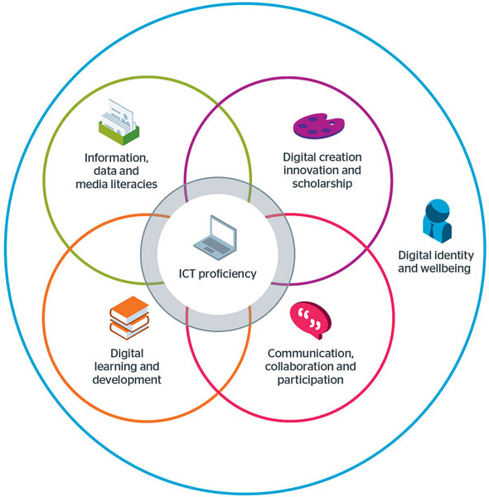
Definitions of Digital Literacy
“Digital literacy” means having a set of skills, competences and attitudes you need to live, learn and work in a society where communication and access to information is largely conditioned by the digital technologies like the internet, online platforms, social media, and mobile devices.
https://www.westernsydney.edu.au/studysmart/home/study_skills_guides/digital_literacy/what_is_digital_literacy

Slide 15
The Benefits of Digital Literacy
A study from the European Commission in 2017 indicated that 90% of professionals are required to possess at least basic digital skills.
Accordingly, within the workplace, employees are required to use information in appropriate ways, interact with others in digital environments as well as create new products and/or ideas collaboratively.

Slide 16
The Benefits of Digital Literacy
Increases Networking: An ability offering connections with like-minded individuals that might be far away and in different time zones but are nevertheless close in reach due to digital communication technologies.
Save money: The services and products that are currently offered online give the ability to Third Sector Organisations (TSOs) to save time and money in the implementation of many administrative and financial tasks such as banking, paying bills or even as simple as shopping.

Slide 17
The Benefits of Digital Literacy
Cyber Security: A very important aspect of being digitally literate is maintaining your security online throughout the digitalisation process. For example, it is important to know how you can protect your passwords or personal information online.
Reaching professional goals: Whilst many people are weary of creating and sustaining an online presence, the benefits it provides for reaching professional goals are immense.

Slide 18
The Benefits of Digital Literacy
Reaching professional goals (Cont.): For example, owning a website, or a page for your organisation on LinkedIn, Facebook, Instagram etc. can boost the reach of the organisation and increase the number of people who are aware of what you do by thousands.
Improve job performance: Digital literacy and the understanding of how to utilise digital technologies is something that can ultimately assist an individual in improving their job performance as now the resources that are given to them are vast and the possibilities of how to use them are endless.

Slide 19
The Benefits of Digital Literacy
Within an organisation it is important for all employees to feel like they can equally contribute to its operations and success.
Providing training to increase digital literacy offers a chance to close the digital divide that could be present between those who can intuitively use and/or make regular use of digital technologies and those who might struggle to understand it and hence, avoid it and hence, make all employees feel like they are equally contributing to the success of the organisation.

Slide 20
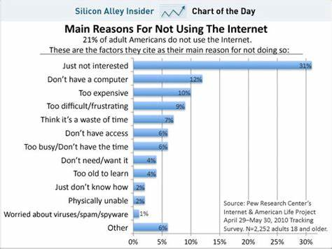
The Challenges of Digital Literacy
A 2020 research report conducted by Capgemini showed that almost half of the world’s population still remains offline.
https://www.businessinsider.com/chart-of-the-day-why-americans-dont-use-the-internet-2010-8

Slide 21
The Challenges of Digital Literacy
Cost: the statistics show that 40% of all offline people in poverty say they have never used the internet because a subscription is too expensive while 56% of offline people aged 22 to 36 say the cost of a device is the reason, they have never used the internet.
Complexity: as seen in a recent report, not all employees have familiarized with modern information and communication tools in their working lives.
“Lack of interest”: there is a need for meaningful opportunities to learn digital skills, to increase the interest of employees and seniors to develop their digital literacy skills.

Slide 22
“Success is not final; failure is not fatal: it is the courage to continue that counts”
Winston Churchill

Slide 23
Competences of Digital Literacy
Shifting from the traditional view of “digital literacy” as a basic knowledge of IT skills, we may now proceed to examine the expanding list of skills, practices and behaviours which are usually associated with digital literacy or else the requirements of what it takes to be a digitally literate person in our rapidly changing society.

Slide 24
Competences of Digital Literacy
Critical Thinking Skills: essential skills as you are often required to be confronted with various information in different formats – searching, sifting, evaluating, applying and producing information all require you to think critically.
Communication: key aspect of digital literacy; needed when communicating in virtual communication rooms, the ability to clearly express your ideas, ask relevant questions, maintain respect, build trust etc.

Slide 25
Competences of Digital Literacy
Practical Technical Skills: using technology to access, manage, manipulate, create information in an ethical and sustainable way. It is a continuous process because of the constant development of new apps and updates in the technological field, so there is an essential need to remain updated!

Slide 26
Competences of Digital Literacy
Collaboration and creativity skills: learning to work with others is a life skill and technology can make collaboration and teamwork much easier.
For example, using online platforms allows users to edit and modify both content and structure collaboratively.
In addition, collaboration will lead to the development of innovative and creative ideas and solutions for the future of the company/organisation.

Slide 27
Competences of Digital Literacy
Online safety skills: identifying potential risks and being conscious about your personal security when working online is also critical in the process of digital development.
Digital Culture: digital culture refers to the culture shaped by the rapid technological developments and the use of digital tools and technologies within a team.

Slide 28
Competences of Digital Literacy
It is noteworthy to mention that being digitally literate changes over time and across contexts (e.g., academic or professional settings), thus digital literacies are essentially a set of skills, practices and behaviours which need to be constantly updated according to the new technological advances and the new trends they create in the professional or academic sectors.

Slide 29
Competences of Digital Literacy
As such, “digital literacies are those capabilities which fit an individual for living, learning and working in a digital society”. Digital literacies are an all-encompassing concept within which various other capabilities can be found.
Hereafter you can find the seven-element model of digital literacies.

Slide 30
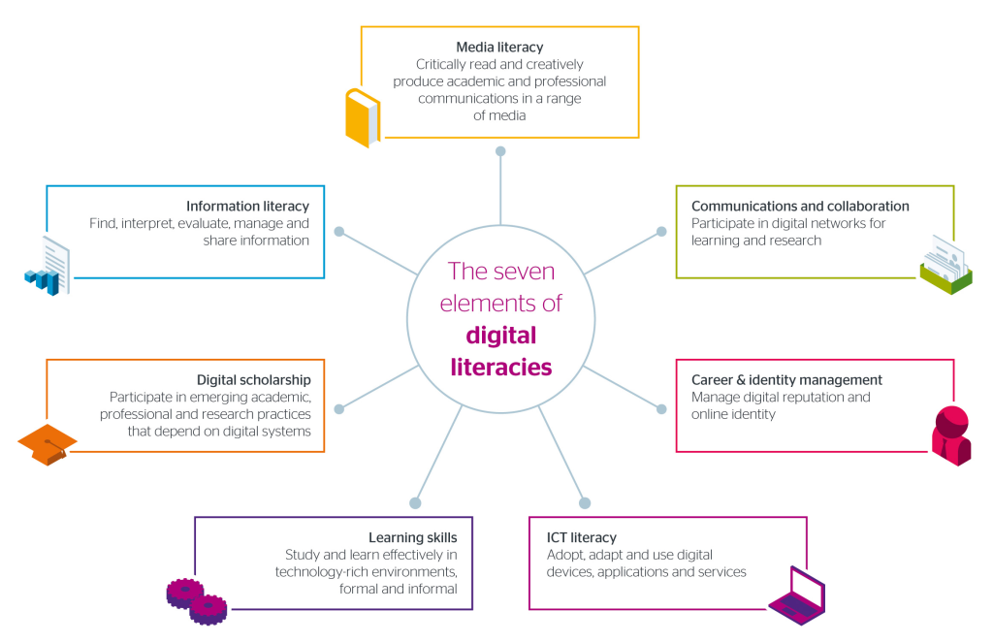
Figure: the seven elements of digital literacies/ source: https://www.jisc.ac.uk/guides/developing-digital-literacies

Slide 31
Digital Leadership
Digital Leaders should be able to inspire others and hence affect their decisions, opinions in developing genuine commitment for the digital objectives of the organisation, developing careers and driving productivity and performance of organisations.
Successful digital leaders are the ones who will adopt tools that enable them to keep the organisation’s goals and work towards them.

Slide 32
Digital Leadership
Digital Leaders can benefit from understanding and incorporating important collaboration and project management tools (e.g., Google Drive, Dropbox, Asana, Slack, Teams, Mailchimp), as well as the use of emails and google calendar in their organisation’s practices.
Additionally, social medial skills along with concrete use of content marketing such as social media status updates, blog posts, videos, infographics and podcasts and analytics for understanding traffic and engagement with content prove very valuable tools.

Slide 33
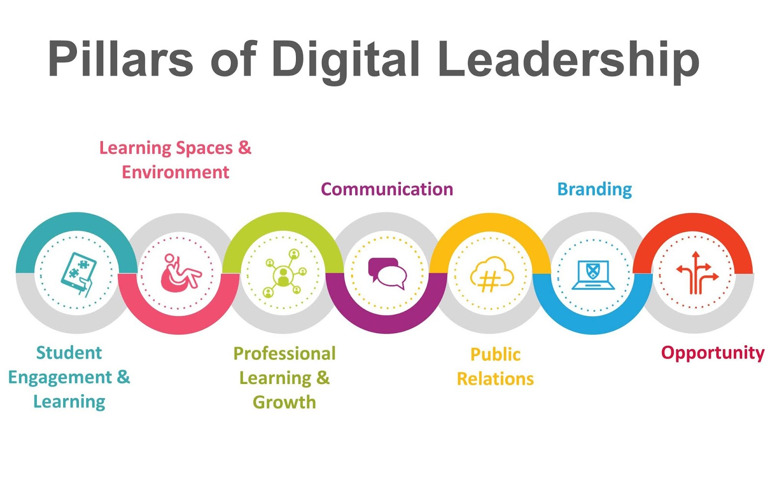
Figure: https://esheninger.blogspot.com/2020/05/the-vital-role-of-digital-leadership-in.html

Slide 34
How Can a Digital Leader Increase the Digital Competencies of Their Team?
Invest in skills training: a continuous training will ensure that your team has the required skills they need in order to succeed in an online or a cloud-based environment.
Incorporate training for your team on internet safety, privacy, and security: today’s global society is creating a new digital culture where rules and social norms are sometimes unclear. Individuals and professionals need to learn how to navigate online, and develop a sense of responsibility about making sound, ethical decisions online and maintain their security.

Slide 35
How Can a Digital Leader Increase the Digital Competencies of Their Team?
Promote entrepreneurial skills: promoting entrepreneurial skills for team will ensure economic growth and development for your company while also advance your team’s ability to succeed in a competitive professional environment.
Invest on improving access to online services: the availability of online services can increase the participation of both remote and in-office employees while increasing their interest and engagement in the company’s goals and facilitate its processes.

Slide 36
Developing Digital Literacy in the Third Sector
In simple terms, “digital literacy” means having the skills you need to live, learn and work in a society where communication and access to information is through the digital technologies like internet, online platforms, social media, and mobile devices.
Therefore, we should consider “digital literacy” not as literacy in the traditional sense of being able to read but rather literacy in the broader sense of development.

Slide 37
“Even if you are on the right track, you’ll get run over if you just sit there”
Will Rodgers

Slide 38
Tips for achieving Digital Literacy in the Third Sector
Develop a Digital Literacy Strategy: to achieve digital literacy in the TS, it is necessary to have a strategic aspiration on digital literacy and form a strategy for achieving your aspirations.
You can start by setting simple goals and specific digital objectives, such as photoshop, digital marketing campaign etc.
Engage senior managers in the process of digitalisation: It is important to ensure that senior managers in the TS are aware of the Digital Literacy Strategy and they are actively involved in the digitalisation process.

Slide 39
Tips for achieving Digital Literacy in the Third Sector
Engage senior managers in the process of digitalisation (Cont.): Managers would also be responsible to ensure that the required digital tools, technological equipment and guidance is in process to support the team in all the steps of becoming digital literate.
Managers should also be responsible to monitor the digitalisation process and set clear strategic objectives.

Slide 40
Tips for achieving Digital Literacy in the Third Sector
Communication and engagement: At this step it is necessary to ensure that your team, consumers and external stakeholders are properly informed about the steps undertaken to ensure digital literacy within your organisation and that they are actively involved in the ongoing changes of your organisation towards digital literacy.
Establish Support Services: At this stage you should ensure that you provide continuous support to your team throughout the digitalisation process to help them smoothly adapt to the digital environment and increase their digital skills and competencies.

Slide 41
Tips for achieving Digital Literacy in the Third Sector
Establish Support Services (Cont.): You should also recognise the value of informal support for your team members, your customers as well as your broader networks and incorporate informal trainings.
Furthermore, training and guidance mechanisms should be in place to appropriately assess the process of digitalisation and monitors the development progress of staff’s digital skills and attitudes.

Slide 42
Tips for achieving Digital Literacy in the Third Sector
Organizational culture: To ensure a successful digitalisation process you should take steps to change the organization’s culture to encompass digital literacy in key operations.
For example, you can invest in new partnership approaches which engage staff, customers and stakeholders and create opportunities for conversation and continuous development through workshops, events and other development opportunities.

Slide 43
Tips for achieving Digital Literacy in the Third Sector
Organizational culture (Cont.): In addition, you should research and understand what influences and motivates your team (i.e., forms of communication, reward and recognition etc.).
Finally, it is very important to know your audience; talk about digital literacy; what it means for your organization’s objectives, your staff and for the beneficiaries and stakeholders involved.

Slide 44
Tips for achieving Digital Literacy in the Third Sector
Measuring change: At this stage you should collect feedback and proceed with changes accordingly to improve your organisation’s digitalisation process. It is also necessary to conduct a new round of research before developing new changes.
You should also enable an evidence-based decision making and inform your team about your future strategies; analyse what works best and what can be improved

Slide 45
Common Mistakes to Avoid When Developing Digital Transformation:
Setting up unrealistic goals and expectations: it is crucial to have a realistic plan, setting your goals clearly and precisely, before starting the process of digital transformation.
Misinterpreting digitization: before you start this process, do a research to understand what digitalisation includes and how your company can proceed towards this direction.

Slide 46
Common Mistakes to Avoid When Developing Digital Transformation:
Neglecting the digital transformation opportunities: it is already established that digital transformation is inevitable. Thus, invest time in identifying new opportunities towards a digital culture.
Not preparing your current team for the foreseeable change: digital transformation is a process that impacts all stakeholders, include the employees and the customers of a company. Investing time in informing all relevant stakeholders about the foreseeable change, will lead to a greater success and a smoother transition.

Slide 47
Common Mistakes to Avoid When Developing Digital Transformation:
Ignoring automation for internal processes (see Module 3 for additional information on Automation): it is critical to ensure the success of your internal transformation, in order to invest in customer-facing transformation processes.
Failing to realise digitization is dynamic: digitalisation is an ongoing and continuous process and therefore your will need to respond to changes quickly while keeping digital transformation at the core of your activities.

Slide 48
Common Mistakes to Avoid When Developing Digital Transformation:
Ignoring key performance indicators: you will need to define the right metrics in order to measure the process and the success of your digital transformation as you move along.

Slide 49
Remesh – “Work form Everywhere” Case Study
The coronavirus pandemic was one of the most fundamental driving forces for rapid technological and digital development in the past couple of years.
Amid the pandemic, individuals and companies alike were forced to adapt to new and often ways of functioning, with many companies relying on applications such as Zoom and Google Hangout to stay digitally connected with their employees.

Slide 50
Remesh – “Work form Everywhere” Case Study (Cont.)
At Remesh, a new “Working form Everywhere” policy was implemented to enable the team members to work from any location.
This has kept the team safe from the uncertainty of COVID-19, but it also left to increased productivity and reduced expenses on office related costs which could then be invested elsewhere.

Slide 51
02
Digital Competences Proficiency Level Framework

Slide 52
Digital Competences Proficiency Level Framework
Under the European Union’s Framework for Digital Competences – DigiComp 2.0
The key components of digital competence are identified in five key areas.

Slide 53
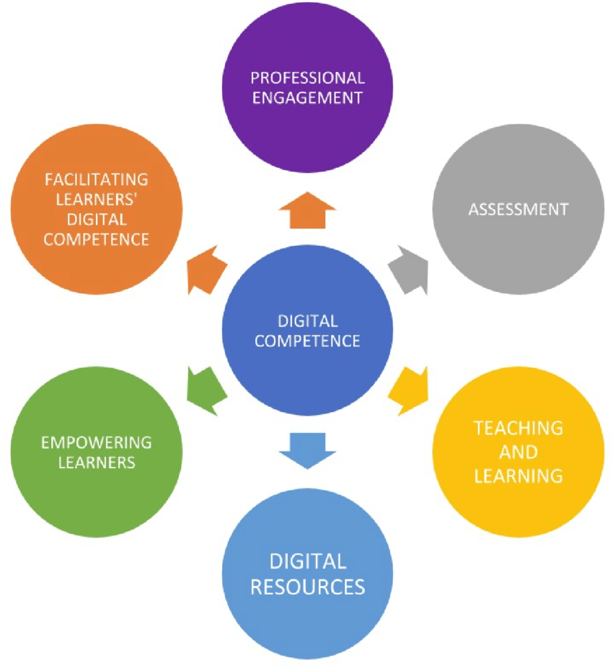
Source: https://www.researchgate.net/figure/The-digital-competence-and-its-areas-own-elaboration-based-on-Redecker-and-Punie-2017_fig1_337089672

Slide 54
Digital Competences Proficiency Level Framework
Information and data literacy:
Articulate information needs; to locate and retrieve digital data, information and content; to judge relevance of the source and its content; to store, manage and organise digital data, information and content.
Communication and collaboration:
Interact, communicate and collaborate through digital technologies while being aware of cultural and generational diversity; participate in society through public and private digital services and participatory citizenship; to manage digital identity and reputation.

Slide 55
Digital Competences Proficiency Level Framework (Cont.)
Digital content creation:
Create and edit digital content improve and integrate information and content into an existing body of knowledge while understanding how copyright and licences are to be applied; know how to give understandable instructions for a computer system.
Safety:
Protect devices, content, personal data and privacy in digital environments; protect physical and phycological health and be aware of digital technologies for social well-being and social inclusion; be aware of the environmental impact of digital technologies and their use.

Slide 56
Digital Competences Proficiency Level Framework (Cont.)
Problem solving:
Identify needs and problems, resolve conceptual problems and problem situations in digital environments; use digital tools to innovate processes and products; keep up to date with digital advancement

Slide 57
Digital Competences Proficiency Level Framework
According to the DigiComp 2.0 Framework the Proficiency Level is categorised in four levels, namely Foundation (Basic), Intermediate, Advanced and Highly Specialised under which there are two sub-levels.
Accordingly, each level represents a step-up in an individual’s acquisition of the competence depending on the complexity of the task, cognitive challenge and their autonomy in completing the task. This module focuses on the Intermediate and Advanced levels of Digital Literacy.

Slide 58
What is the level of digital proficiency at your organisation?
There are various ways for assessing digital skills levels:
Self-assessments
Knowledge-based assessment
Performance-based assessment
Link for examples: Digital Skills Assessment Guidebook

Slide 59
“There are no secrets to success. It is the result of preparation, hard work and learning from failure.”
Colin Powell

Slide 60
Practical Apps & Tools to Support Data Literacy
Graph Literacy App
Gapminder Tools
Google Trends

Slide 61
Practical Apps & Tools to Support Data Literacy
Google GIF Maker
Basics Statistics App
Tableau Mobile App

Slide 62
Online Tools to Support Communication and Collaboration
Slack
Microsoft Teams
Basecamp

Slide 63
Online Tools to Support Communication and Collaboration
Trello
Zoom
Asana

Slide 64
Establishing a culture of collaboration:
A culture of collaboration helps an organisation ot maximise employee knowledge, skills and competencies through the exchange of ideas and information.
A study conducted by the Institute of Corporate Productivity concluded that companies with with a collaborative culture are mora than five times more likely to be high-performing that companies without a collaborative approach.
Source: https://www.peoplematters.in/site/interstitial?return_to=%2Farticle%2Fculture%2Fdiverse-and-collaborative-culture-is-a-powerful-competitive-advantage-15120

Slide 65
How could you establishing a culture of collaboration?
Communicate a clear vision: this process includes the establishment of a set of desired behaviours and altitudes which will be shared amongst employees.
Hire and develop collaborative leaders: leaders with the a strong commitment to teamwork and resource-sharing can contribute towards the creation of a collaborative management style.
Create opportunities for collaboration: joint team projects, cross-functional focus groups and the establishment of group chats for exchanging of information are useful tools for promoting a collaborative culture within an organisation.
Leverage social collaboration tools: in the digital age, internal social networks and cloud-based tools can be instrumental in promoting collaboration.
Reinforce and revisit your approach: establishing collaboration is an ongoing process and continuous monitoring is necessary in ensuring the establishment of a collaborative culture.

Slide 66
Online Tools for Digital Content Creation
GIPHY
SurveyMonkey
Snappa
Wideo
Venngage
Meme Generator

Slide 67
Online Tools for Digital Content Creation (Cont.)
GameFroot
NoNotes
Checklist
Designspiration
PhraseGenerator
ThingLink
Link to tools

Slide 68
What is the importance of content creation?
Content creation is the basis of digital marketing and, as a result, companies and organisations use online content creation tools to create their content and reach their target audience.
The creation of content for the promotion and marketing of an organisation is closely linked to the establishment of a marketing strategy.

Slide 69
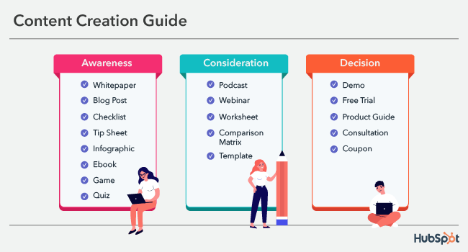
Source: https://blog.hubspot.com/marketing/content-creation

Slide 70
VPN Software
ExpressVPN
ACCESS
CyberGhost
IPVANISH
Surfshark
Link to tools

Slide 71
VPN Software (Cont.)
PrivateVPN
Hotspot Shield
NordVPN
STRONGVPN
Purevpn
Link to tools

Slide 72
Online Tools for Digital Content Creation: Antivirus Software
TOTALAV
Norton
Bitfinder
Panda
Link to tools

Slide 73
Antivirus Software (Cont.)
Avira
PCPROTECT
McAfee
Avast
Link to tools

Slide 74
Problem-solving Tools:
Fishbone diagrams
Flowcharts
Strategy maps
Mental maps
Idea maps
Concept maps
Layered process audit software
Charting software
MindManager
Link to tools

Slide 75
PDCA Cycle: Plan, Do, Check, Act
The PDCA cycle, or else known as the Deming Cycle, provides as effective set of guidelines for successful problem solving.
It was introduced by Dr. Edwards Deming in the early 1920s as a three-step linear problem-solving method:
Plan: investigate the current situation and identify the problem.
Do: identify the roots and causes of the problem and create an action plan to solve the issue.
Check: monitor the effectiveness of your solution/approach.
Act: once you are satisfied with the effectiveness of your solution, implement all necessary actions to solve the problem.

Slide 76
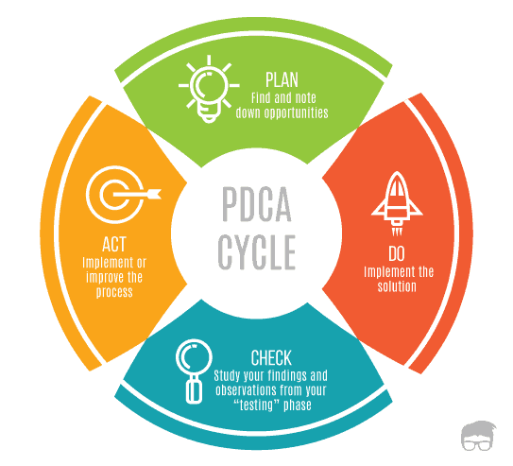
Source: https://www.feedough.com/deming-cycle-pdca-cycle/

Slide 77
03
Digital Marketing

Slide 78
Digital Marketing
Digital Marketing or Online Marketing is an essential aspect of any digitally advanced TSO that is able to harness the benefits of digital transformation.
In its essence digital marketing allows for the promotion of initiatives, actions, causes etc., for TSOs and in doing so to connect them with potential interested individuals using the internet as well as other forms of digital communication such as the email, social media, web-based advertisements, text and multimedia messages as a marketing channel.

Slide 79
Digital Marketing
Any form of digital communication that is being delivered by TSOs can be considered digital marketing.
The importance of digital marketing for TSOs becomes apparent when one realizes the potential it has for raising awareness to relevant stakeholders and beyond.

Slide 80
Digital Marketing
Digital marketing has the ability to remove the limitations and boundaries of accessibility as well as time whilst adding convenience and expanding the reach of communication.
In other words, it becomes easier for people to not only hear about a specific initiative but also to spread the word further.

Slide 81
Digital Marketing
A concrete digital marketing strategy can improve the online visibility of the organization – making you stand out from the crowd – and hence, increasing competitive advantage over other TSOs in a similar field.
In addition, the improved visibility that digital marketing allows for TSOs provides an opportunity for more and more people to become engaged as volunteers in the implementation of specific activities.

Slide 82
Digital Marketing
On the other hand, TSOs are able to build and maintain credibility by utilizing digital marketing as they now have the ability of sharing powerful stories achieved, carrying out email marketing campaigns that take interested individuals through your organization’s journey and therefore, building trust and loyalty with supporters.

Slide 83
Digital Marketing
As such, Digital Marketing is a powerful tool to be utilized by digitally literate TSO leaders. Module 2 of the training program will dive deeper into the processes of communication within digital marketing.

Slide 84
Tips on Developing a Digital Marketing Policy
Know your audience: it is very important to know the needs of your customers, your team as well as you stakeholders’ needs when forming a digital marketing campaign.
Review your website’s analytics: this will enable you to understand your audience better and to assess your successes and potential fields for development.

Slide 85
Tips on Developing a Digital Marketing Policy
Consider search engine optimization: you should focus on prioritising the information on your website and social media accounts to attract a wide audience and bring in more traffic.
Use social media: social media accounts can drive interest in your company and help you improve your brand awareness.

Slide 86
Tips on Developing a Digital Marketing Policy
Bring in specific professionals whenever needed: taking care of your website and social media account might require people with specific skills.
It is important to identify when adding a new staff member will benefit your company to ensure professionalism and continuous development.

Slide 87
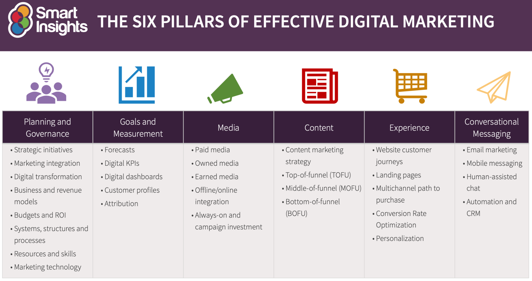
Source: https://www.smartinsights.com/digital-marketing-strategy/digital-strategy-development/10-reasons-for-digital-marketing-strategy/

Slide 88
“The only way around is through.”
Robert Frost

Slide 89
The Benefits of a Digital Marketing Policy
Increase customer loyalty: digital marketing can help you customize your clients’ experiences (i.e., personalised email offers, social media engagement etc.), thus increasing the trust your customers have in your company.
Engage customers into the company’s operations: a customer’s journey is not always a simple process to analyse and understand, but digital marketing makes it easier to track this process.

Slide 90
The Benefits of a Digital Marketing Policy
Target the right audience: digital media platforms allow you to target a specific audience while also keeping a track of an individual’s online activities and demographic information.
Create consistency: with a digital marketing policy in place, it is easier to monitor traffic and maintain consistency when delivering results based on your customers’ and stakeholders’ needs.

Slide 91
The Benefits of a Digital Marketing Policy
Measure results accurately: there are many opportunities to track your company’s successes with digital marketing, such as knowing when a visitor clicked on specific ads, how many people visited your website and social media accounts etc.
Build brand credibility: tracking the needs of your clients will help you provide them the necessary answers and as a result you will build credibility for your company among customers and stakeholders.

Slide 92
The Benefits of a Digital Marketing Policy
Lower cost: spending time to plan a well targeted digital marketing campaign can reach the right customers at a much lower cost than traditional, offline marketing methods.

Slide 93
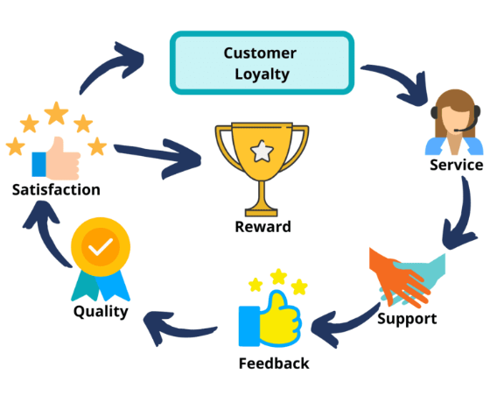
Source: https://digifix.com.au/how-to-improve-customer-loyalty-with-digital-marketing/

Slide 94
Challenges in Establishing a Digital Marketing Policy
Learning about your clients: when developing a digital marketing campaign, it is necessary to known exactly what your target audience wants.
You should avoid spending money and time on content and key words that are too broad or poorly targeted.
To avoid this challenge, you can learn more about your audience through surveys, polls and questions on your social media pages.

Slide 95
Challenges in Establishing a Digital Marketing Policy
Generating qualified lead: as companies increase their digital transformation speed, competition increases and as a result choosing the right lead generation practices is necessary in order to save money and time.
For example, is your target using Facebook or are they professionals with active presence on LinkedIn? Knowing your target audience well will help you avoid this issue.

Slide 96
Challenges in Establishing a Digital Marketing Policy
Create engaging content: creativity and innovation are two key terms that will enable you to avoid this challenge and create engaging content for your audience.
There are many forms of marketing material which you can create such as podcasts, visual infographics, social media stories etc.

Slide 97
Challenges in Establishing a Digital Marketing Policy
Complying with privacy and data-sharing regulations: GDPR regulations are very critical in both offline as well as online digital marketing.
You need to ensure that you comply with any laws covering your country as well as the with the laws covering the population in your target audience.

Slide 98
Challenges in Establishing a Digital Marketing Policy
Making websites accessible: accessibility is another fast-growing issue that is very relevant to the process of digitalisation as well as in digital marketing. There are several steps you can take to ensure accessibility.
For example, you can use a mixture of audio, visual and alt text content to ensure that visually impaired users will still be able to access your website.

Slide 99
Thinking about developing your own Digital Marketing Policy?
Before putting a digital marketing plan into motion, it is important to ensure that your strategy includes all the main aspects of a Digital Marketing Policy. A few questions to think about are:
Have you defined your main objective and goals?
Have you identified your main target audiences?
Have you identified the main communication channels used by your audience?
Have you found a way to measure the success of your policy?

Slide 100
The main steps for the development of Digital Marketing Policy
Creating your identity: digital marketing can help you define your cause and spread awareness about your operations to a wide audience.
Improve your web design: a website is a fundamental part of all organisations, including TSOs.
Putting yourself out there: digital marketing can help you be active and present within a competitive market and put yourself out there to compete with the business sector.

Slide 101
Evaluating your Digital Marketing Policy
Carrying out an analysis of your marketing policy is a way to identify its main strengths and weaknesses and help you develop solutions to potential problems.
A useful framework for this process is the SWOT analysis which offers an opportunity to look at the strengths, weaknesses, opportunities and threats for your digital marketing policy.
Online tools for a SWOT analysis: VisualParadigm, Alignment, Creately, etc.

Slide 102
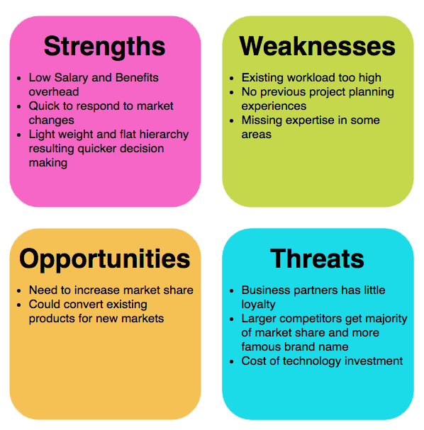
Source: https://www.visual-paradigm.com/guide/strategic-analysis/what-is-swot-analysis/

Slide 103
The Fanatics Case study
Fanatics, an e-commerce store selling sports apparel saw a major increase on their sales when they decided to use digital content marketing to provide their customers with more reasons to engage with the company’s website. The company used AdWords, Google Shopping and Facebook campaigns to reach a wider target and establish an ongoing engangment with potential customers.

Slide 104
04
Digital Corporate Culture

Slide 105
Digital Corporate Culture
The digital transformation that we are currently undergoing with the implementation and use of newer, faster and more often than not changing digital technologies require not only a shift in the skills and competences of the employees but also in the organisational culture that will help them forge new business models (Cassidy 2019).

Slide 106
Digital Corporate Culture
As such, organisational leaders need to recognize digital transformation as a fundamental paradigm shift which requires instilling a culture that assists this change, transmitting the benefits of digitisation and that enable’s the realisation of the company’s overarching strategy.

Slide 107
Digital Corporate Culture
Doing so will give the opportunity to organisational leaders to set the values and characteristics that guide how things should be done in an organisation and ultimately steering the employees to make choices and act in an appropriate manner which advances the organization’s strategy as well as goals.

Slide 108
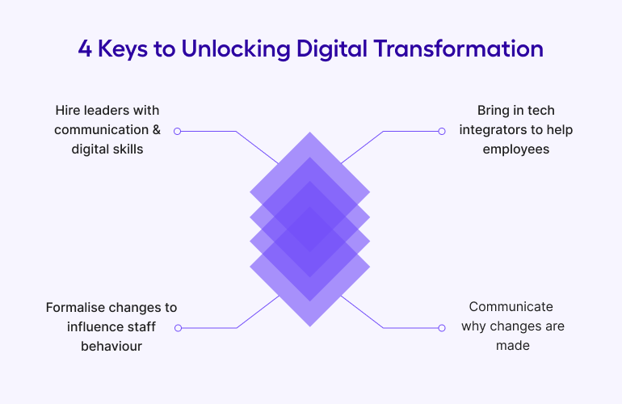
Source: https://get.apicbase.com/digital-transformation-restaurants-culture/

Slide 109
“Always deliver more than expected.”
Larry Page

Slide 110
How to Lead as a Digital Leader
Focus on innovation: a successful digital leader should be focused on innovation and identifying continuous potentials for development and improvement.
Secure funding: equally important for a digital leader would be the ability to ensure funding that will enable the creation and delivery of training and bonding activities.

Slide 111
How to Lead as a Digital Leader
Set clear goals and communicate them: it is essential for a leader to have excellent communication skills and being able to interact with their team setting goals for the development of the company.
Get to know your team: a leader that does not know their team members won’t be able to communicate with them effectively in order to bring trust in their leadership skills as well as in the company as a whole.

Slide 112
How to Lead as a Digital Leader
Assess your digital tools: it is critical to invest in continuous development and as a result the leadership should know it the current tools are up to the challenge of digitalisation or if they need replacement.

Slide 113
The Main Characteristics of Digital Corporate Culture
Customer-centric: having a set of values that put your customers at the front of your activities and operations.
Data-driven: placing data at the core of a company’s development will enable the company to track its successes and identify potentials for continuous improvement.

Slide 114
The Main Characteristics of Digital Corporate Culture
Risk taking and innovative: taking risks might lead to some failures but it is also the first step towards innovation and development. Every step is a learning process after all!
Collaboration: providing a safe environment for people to corporate within a company will increase creativity and productivity within a team and is will lead to the development of cross-departmental solutions for potential issues.

Slide 115
The Main Characteristics of Digital Corporate Culture
Agile: agility will enable the entire workforce to be more adaptable and accountable, accept failure as part of the overall process and as a learning experience while seeking constant improvement.
Transparent: transparency boosts trust and enhances customers’ and employees’ engagement with the activities of a company leading to better results and increase in profit.

Slide 116
The Main Characteristics of Digital Corporate Culture
Lifelong learning: technological and digital developments are ongoing and as a result the process of digital transformation is an ongoing activity. As a result, maintaining a digital corporate culture requires time and lifelong learning.

Slide 117
The Main Challenges of Adapting Digital Corporate Culture
Understanding the concept of a digital corporate culture: it is necessary to know the steps of digital transformation and what these would imply for the corporate culture of the company.
Therefore, companies should not underestimate the process of planning and setting clear goals before starting the transition into a digital corporate culture.

Slide 118
The Main Challenges of Adapting Digital Corporate Culture
Close the leadership-employee gap: when studying the process of developing a digital corporate culture, it has been observed that one of the main challenges is the leadership-employee gap.
The leadership (or a lack thereof) plays a major role in the corporate culture of a company and as a result it is necessary to establish mutual understanding and common goals between the managers and the staff.

Slide 119
Trying to establish a Digital Corporate Culture?
Human resistance to change is natural and, as a result, it is natural to face obstacles when trying to establish a digital culture. The most common obstacles in this process are:
The leadership not recognizing the importance of a digital culture when planning for digital transformation.
The corporate culture is integrated into everyday work and it is difficult to implement changes to it.
Everyone is becoming more digitally literate and it is therefore easy to identify when leadership does not possess the appropriate digital skills.
The empowerment of employees when initiating a change is a crucial part of the establishment of a digital culture.

Slide 120
Tips to overcome potential challenges and establish a digital culture
Focus on the people: it is very important to provide help to your employees to help them engage with the change.
Start from the top: when it comes to the establishment of a digital culture, senior management holds the key.
Embrace technology: efficient digital transformation can help you manage various data, integrate new tools and enable exchange of information in real time.
Communicate a shared vision: get your employees invested in the change you are making and make sure they feel empowered throughout the changing phase.

Slide 121
Tandem Method for Meeting Digital Needs/Goals
Tandem is a world leading Continuous Performance Management platform which helps organisations, including TSOs, to adapt to a new, digital corporate culture and prepare for a customer-focused era amid the rapid technological and digital developments:
Develop leaders into coaches
Driving employee-owned development
Simple to use, enterprise-ready and measurable

Slide 122
Case Study – The Digital Transformation in Levi’s
Traditionally, innovations within LS&Co. would take months or even years to be developed and launch.
The outbreak of the coronavirus pandemic, however, led the company in a sprint to develop new opportunities and develop a work-from-home setting within weeks.

Slide 123
Case Study – The Digital Transformation in Levi’s
It was a rough start in the development of a digital corporate culture for the company but it eventually led to numerous benefits, such as increasing creativity, finding solutions faster and with less cost and increasing productivity.
Source: https://venturebeat.com/ai/how-levis-uses-ai-to-accelerate-its-design-process-and-digital-transformation/

Slide 124
Individual Work
Please add the suggested practical exercise, preparation for assessment, other individual studies.
For example, course work to develop and implement an Innovative project with a challenge-based approach. Innovative project is recommended to be developed and implemented together with local stakeholders to addressing the local challenges (section 2.3). After the completion of 6 modules, the TSOs leaders could pitch their Innovation projects for the stakeholders (region/ city/ industry). It will stimulate the bottom-up approach mind-set of TSOs leaders/ TOP managers/ employees and will strengthen interaction, engagement, and a positive effect on the local and regional community.

Slide 125
05
References

Slide 126
References
https://upriseup.co.uk/blog/charity-digital-literacy-reports/
https://www.capgemini.com/2020/09/digital-literacy-in-the-times-of-covid/
https://joinup.ec.europa.eu/sites/default/files/document/2014-12/How%20to%20strenghten%20digital%20literacy%20-%20Practical%20example%20of%20a%20European%20initiative%20SPreaD.pdf

Slide 127
References
https://news.microsoft.com/cloudforgood/_media/downloads/en/digital-literacy-en.pdf
https://www.westernsydney.edu.au/studysmart/home/study_skills_guides/digital_literacy/what_is_digital_literacy#:~:text=Digital%20literacy%20means%20having%20the,social%20media%2C%20and%20mobile%20devices
https://www.webwise.ie/teachers/digital_literacy/

Slide 128
References
https://www.diggitmagazine.com/wiki/digital-culture#:~:text=Digital%20culture%20refers%20to%20culture%20shaped%20by%20the,personal%20computers%20and%20other%20devices%20such%20as%20smartphones.
https://www.loginradius.com/blog/growth/7-mistakes-companies-make-during-digital-transformation/

Slide 129
References
https://thirdsectorlab.co.uk/11-must-read-digital-inclusion-reports-and-case-studies/
https://blog.remesh.ai/3-key-case-studies-for-successful-digital-transformation
https://dataschools.education/apps-tools-to-support-data-literacy/
https://www.educationalappstore.com/blog/4-best-apps-increasing-data-literacy-skills/

Slide 130
References
https://www.raconteur.net/technology/top-10-communication-and-collaboration-tools/
https://www.outbrain.com/blog/12-awesome-digital-content-creation-tools/
https://anvl.com/blog/keys-to-successful-digital-transformation/
https://blog.mindmanager.com/blog/2020/07/07/202007problem-solving-tools/

Slide 131
References
https://www.lumapps.com/solutions/digital-transformation/digital-transformation-tools/
https://tedigitalmarketing.com/digital-marketing/5-tips-to-creating-a-successful-digital-marketing-strategy/
https://www.nibusinessinfo.co.uk/content/advantages-and-disadvantages-digital-marketing

Slide 132
References
https://www.cardinaldigitalmarketing.com/blog/top-9-benefits-of-digital-marketing/
https://linchpinseo.com/challenges-facing-digital-marketers/
https://redmediauk.com/marketing-in-the-third-sector/
https://www.husson.edu/online/blog/2021/07/marketing-case-studies

Slide 133
References
https://digileaders.com/how-to-lead-a-successful-digital-team/
https://knolskape.com/blog-characteristics-of-digital-culture/
https://www.capgemini.com/fi-en/wp-content/uploads/sites/27/2018/09/dti-digitalculture_report_v2.pdf
https://www.ourtandem.com/

Slide 134
References
https://hbr.org/2022/02/4-lessons-from-levis-digital-transformation
https://www.renaissance.com/2019/02/08/blog-digital-literacy-why-does-it-matter/#:~:text=The%20American%20Library%20Association%20(ALA,both%20cognitive%20and%20technical%20skills.%E2%80%9D
https://www.westernsydney.edu.au/studysmart/home/study_skills_guides/digital_literacy/what_is_digital_literacy

Slide 135
References
https://www.jisc.ac.uk/guides/developing-digital-literacies
https://techboomers.com/importance-of-digital-literacy
https://gdsgroup.com/insights/marketing/blueprint-for-digital-leadership/#:~:text=Digital%20leadership%20is%20the%20strategic,for%20overseeing%20the%20digital%20assets
https://gdsgroup.com/insights/marketing/digital-transformation-framework/

Slide 136
References
https://careerwise.co.za/digital-literacy/
https://ec.europa.eu/digital-single-market/en/news/new-report-shows-digital-skills-are-required-all-types-jobs
https://upriseup.co.uk/blog/charity-digital-literacy-reports/
https://www.smartsheet.com/content-center/executive-center/digital-transformation/how-achieve-five-competencies-effective-digital-leaders

Slide 137
References
https://www2.deloitte.com/content/dam/Deloitte/uk/Documents/public-sector/deloitte-uk-decoding-digital-leadership.pdf
https://theonebrief.com/the-digital-leader-core-competencies-for-a-new-era/
https://www.redhat.com/en/services/consulting/open-innovation-labs?sc_cid=7013a00000269xoAAA&gclid=CjwKCAiApfeQBhAUEiwA7K_UH-a88Ob-on_rMBHiP3zMRabjf-h7cLci5kaes4cUGxN8KDh__kImxBoChDUQAvD_BwE&gclsrc=aw.ds

Slide 138
References
https://www.redhat.com/en/engage/organize-for-innovation-20180913?sc_cid=7013a00000269xpAAA&gclid=CjwKCAiApfeQBhAUEiwA7K_UHxPdDVA1s1OIJyVgw-8bDauRMsyT-ADFsErR-faXFBHkHVwvu2qP6BoC4FQQAvD_BwE&gclsrc=aw.ds

Slide 139
Thank you
Any questions?
www.leaderseeds.eu

