Slide 1
Effective Digital Communication
Module 2
www.leaderseeds.eu

Slide 2
Heading
01
What is communication?
“Everyone can be great because everyone can serve.”
– Martin Luther King Jr.
02
Inbound Marketing
03
Storytelling
04
Communication Tools

Slide 3
Introduction
In this course, TSO leaders will learn how the internal and external communication of the organisation can be improved, addressing the common miscommunication issues at the workplace.
Additionally, they will learn the importance of Storytelling for boosting the brand, as well as communication strategies for the organisation.
Furthermore, they will evaluate organizational performance by using KPIs.

Slide 4
Instructional & Learning Objectives
Learning Goal:
Learners will understand which appropriate digital communication means should be used for given context, as well as how to interact through a variety of digital technologies.

Slide 5
Instructional & Learning Objectives
Instructional Objectives:
Learners will be introduced to data, information and digital content sharing.
Learners will be instructed in graphic design, digital communication strategies, paid and targeted advertising, and data analytics.

Slide 6
Instructional & Learning Objectives
Learning Objectives:
Learners will be able to design, plan, schedule and evaluate communication actions, posts, campaigns, newsletters, etc.
Learners will be able to design considering the colours, typography, structure, and relevance.
Learners will apply creative thinking, as well as how to analyse and evaluate data obtained.

Slide 7
Instructional & Learning Objectives
Learning Objectives (Cont.):
Learners will be able to monitor what is working and identify possible gaps while communicating internally and externally.

Slide 8
Competencies Gained
Learners will demonstrate the ability to customise privacy settings; find and use key hashtags, as well as create strong branded hashtags.
Learners will have the basic ability to cover events live on social media (live-tweeting, posting) and engage with online participants during an event.
Learners will demonstrate basic photo editing skills as well as the ability to overlay text; and will show competency in operating various photo editing apps.

Slide 9
Competencies Gained
Leaners will demonstrate the ability to contribute ideas to larger strategies with supervision, as well as gain a basic knowledge of in-platform scheduling tools.
Learners will gain a basic knowledge of filters to target posts according to demographics; a knowledge of when and how to boost posts; and the ability to create trackable links.
Learners will gain a basic understanding of key terms such as clicks, views, reactions, etc., as well as an understanding of Google Analytics.

Slide 10
Module Duration
2-3 hours content (please allocated time devoted to theoretical part, exercises and individual work)

Slide 11
01
Communication

Slide 12
Communication
Communicating in person is different from communicating online. When you communicate with someone face to face, you can hear their tone of voice, see their facial expressions, body language, and hand gestures. These methods of communicating cannot be relied upon in the online environment

Slide 13
What Is Communication? The Elements of Communication
Communication can be defined as the process of transmitting information and common understanding from one person to another (Keyton, 2011).
Within organisations, communication is the key to ensuring clear communication with workers and stakeholders.
Understanding what to communicate and how to communicate will lead to achieving better results, improving our internal work, and, consequently, ensuring the quality of content.

Slide 14
What Is Communication? The Elements of Communication
None of this happens without a clear strategy and understanding of the different elements the communication has.
Traditionally, communication has been understood as a linear process in which the sender sends a message to the receiver.
However, this linear model does not take into the consideration aspects of relevant importance, such as the context where the message had taken place, the noise or the factors that can interfere while communicating, or the process of encoding and decoding the message.

Slide 15
Theories of Communication
WATCH
The following video summarises the existing theories of communication.

Slide 16
Internal Communication
Internal communication represents the communication that happens inside of the workplace. Essentially, it focuses on how the organisation’s team members and leaders communicate with each other.
Welch & Jackson (2007) and Welch (2012) claim internal communication is a range of formal and informal communication between employees and employers.

Slide 17
Internal Communication
Every organisation chooses the best way to communicate, therefore, there is not a unique way of communicating internally.
Internal communication does not mean only employee-employer, Welch & Jackson (2007) view the internal communication from the perspective of stakeholders, which has been recognised as a comprehensive picture of internal communication from the insight of an organisation.

Slide 18
Internal Communication
The main goals of internal communication are keeping staff informed of any changes and the company’s strategies and facilitating engagement.
Employees increasingly demand involvement and participation in conversations that could drive organisational changes, and they expect senior managers to listen to and act upon their feedback (Bui, 2019).

Slide 19
Tips and Tricks to Improve Internal Communication
Sticky information such as preparing documents or working according to the organisation’s workflow could be accessible for employees during their first weeks of training.
Use internal documents to be used as references.

Slide 20
Tips and Tricks to Improve Internal Communication
Share the values and brand awareness with your employee.
Promote a culture of active listening whether employers and employees are willing to share and feel listened to.

Slide 21
Tips and Tricks to Improve Internal Communication
Open discussions are great always to boost creative thinking and problem solving where everyone takes part.
Embrace an open collaborative workplace where information is shared on a regular basis.

Slide 22
Synchronous and Asynchronous Communication
Engage in real-time connections or communicate at your own pace! Let's explore the types of online communication.
Synchronous communication:
Happens in real-time but different locations.
Examples: Online chats, video conferencing, and virtual meetings.
Connect with colleagues, volunteers, or stakeholders instantly.
Useful for scheduled discussions, brainstorming sessions, or quick updates.

Slide 23
Synchronous and Asynchronous Communication
Asynchronous Communication:
Occurs at different times and places.
Allows flexibility and convenience.
Examples: Email, discussion forums, and social media platforms.
Share ideas, collaborate, and engage at your own convenience.
Great for in-depth conversations, sharing resources, or community engagement.
Remember, non-profit organizations can leverage both types to foster collaboration, support remote teams, and engage with the community effectively. Choose the right approach based on the nature of your communication and the needs of your organization.

Slide 24
How to improve virtual communications
In virtual communication, we tend to be more prone to judgements. It’s easier for our brains to create negative narratives about a certain situation happening in a virtual conversation. This is often because we don’t see peoples faces (if an exchange is in writing), or we don’t know the person enough.
Here are some tips to avoid virtual communication falling into negativity:
Be flexible – meetings, camera off/on, styles of expressing thought, this can all differ from person to person, day to day, and that is still ok
Be intentionally empathetic – try putting yourself in another person's shoes before replying
Ask questions – try to understand the other point of view, but be subtle
Be forgiving – your peers or lecturers are just people, just like you
Build relationships – each communication is a chance for a long-lasting connection

Slide 25
“So the whole war is because we can't talk to each other.”
― Orson Scott Card, Ender's Game

Slide 26
Miscommunication at the Workplace
As we have seen human communication is complex. Commonly, miscommunication is produced when two or more people can not find a common understanding.
At the workplace, miscommunication might happen in hieratical systems where the employee does not feel strong enough to express himself/herself.

Slide 27
Miscommunication at the Workplace
The fact is that miscommunication can happen at any moment regarding a deadline, task, or unclear internal communication between employer/employee.
Although considered extremely important and art itself, this competence is not understood as important enough.

Slide 28
Miscommunication at the Workplace
Extracted from a practical example regarding the use of emails in the workplace, (Thomas et al., 2012) identified some negative factors derived from the use of E-mail, such as information overload and miscommunication.

Slide 29
The use of e-mails at the workplace
Information overload | Miscommunication
Receiving more e-mails than one can handle | Poor media selection, inappropriate use of email:
Receiving an increasing number of irrelevant emails, including spam | message too complex for e-mail’s “leanness” • other media more appropriate or efficient
Work being interrupted frequently by e-mails. | information deficiency:
Interruptions leading to inefficient use of time | ambiguous messages poorly structured messages (messages that are not to the point) messages hard to understand messages not clearly stating required action ineffective use of the subject line
A feeling of time pressure as senders require direct responses
Source: Extracted from Jackson, T. W., & van den Hooff, B. (2012). Understanding the factors that affect information overload and miscommunication within the workplace. Journal of Emerging Trends in Computing and Information Sciences, 3(8), 1240-1252

Slide 30
The Use of E-mails at the Workplace
This example provides a clear understanding of how a bad use of email affects severely the productivity of the employee, provokes distractions, and creates stress.
From this example, we could extract that a ¨clear e-mail policy¨ could benefit the communication management of the organization.

Slide 31
How Miscommunication happens and how to Avoid it
The following video resumes how miscommunication is produced and useful tips on how to avoid it.

Slide 32
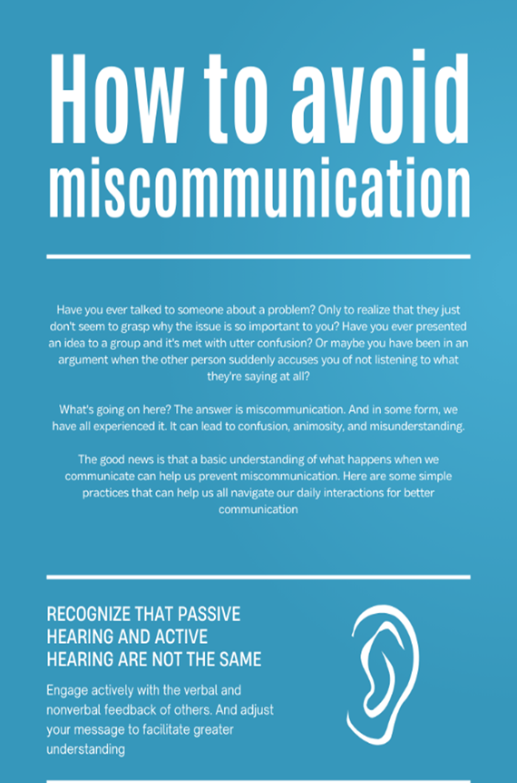
How to avoid Miscommunication
Have you ever talked to someone about a problem? Only to realise that they just don’t seem to grasp why the issue is so important to you. Have you ever presented an idea to a group, and it's met with utter confusion?
What’s going on here? The answer is miscommunication. It can lead to confusion, animosity and misunderstanding.
The good news is that a basic understanding of what happens when we communicate can help us prevent miscommunication.

Slide 33
How to avoid Miscommunication
Here are some simple practices:
Recognise that passive hearing and active hearing are not the same.
Engage actively with the verbal and nonverbal feedback of others and adjust your message to facilitate greater understanding.
Listen with your Eyes, Ears and Gut.
Remember that communication is more than just words.

Slide 34
How to avoid Miscommunication
Take time to understand as you try to be understood.
In the rush to express yourself, it’s easy to forget that communication is a two-way street. Be open to what the other person might say.
Be aware of your personal perceptual filter.
Elements of your experience, including your culture, community and family influence how you see the world. Say, ”This is how I see the problem, but how do you see it?” Don’t assume that your perception is the objective truth. That will help you work towards sharing a dialogue with others. To reach a common understanding together

Slide 35
External communication
External communication includes the communication between an organisation and its stakeholders outside the company such as customers, suppliers, intermediaries, investors, or society in general (Kuşçu, 2020).

Slide 36
External communication
The ways external communication has evolved represent the irruption of digital transformation.
Understanding new ways of communication will lead to the development of better strategies to reach the target audience.

Slide 37
Tips for Better External Communication
Tracking what is working is important to assess the strategies and consequently, find any gaps during the communication process.

Slide 38
Tips for Better External Communication
Layouts build consistency to the image of your company and workers, a good design might be linked with the branding awareness of your organization.

Slide 39
Tips for Better External Communication
Interactive content is an easy way to see if the target audience is engaged and takes action to obtain more information about the organisation.
In addition, do not be afraid of asking for suggestions on how to improve the communication process within your organisation.

Slide 40
Tips for Better External Communication
Whether it is internally or externally, the feedback received might open new doors for innovating and developing new ways of communication.

Slide 41
“If your actions inspire others to dream more, learn more, do more and become more, you are a leader.”
John Quincy Adams

Slide 42
02
Inbound Marketing

Slide 43
Marketing in the Non-Profit Sector
In the previous section we discussed how organisational communication can be divided into external and internal communication
External communication is essential for the non-profit sector, both for communicating with your service users or beneficiaries and for linking your cause with donors
Types of external communication include, public relations, personal selling, customer service, and corporate communication but for this module, digital Marketing is the key part we will focus on
Nonprofit marketing is the use of marketing tactics and strategies to amplify an organization's cause and mission, solicit donations, and attract volunteers and supporters.

Slide 44
Inbound vs Outbound Marketing
Inbound Marketing
Paid Search Marketing
Content Marketing
Outbound Marketing
Cold Calling
Interruptive Ads
Opt-in E-mail Marketing
Email Spam
Traditionally Marketing followed a linear model and was focused on reaching out directly to your Target Group
In the Digital World Inbound Marketing has become much more prevalent

Slide 45
Inbound vs Outbound Marketing
Inbound Marketing: Focuses on attracting potential customers or donors through unpaid promotion and content marketing, such as SEO, social media, blogging, and producing valuable content. It aims to draw leads in a natural and non-intrusive way, fostering engagement and building relationships.
Outbound Marketing: Relies on paid methods to "buy" the attention of potential leads through tactics like paid advertising, press releases, and dedicated sales teams. It interrupts the target audience's normal browsing or reading experience and is often considered intrusive.
Key Difference: Inbound marketing is about attracting leads organically by providing value and building connections, while outbound marketing seeks to reach leads through paid advertising and direct outreach, often interrupting their experience.

Slide 46
Why invest in Inbound Marketing?
For many Non-profits, we’re focused on our cause and taking the time to develop a Marketing plan can feel like a waste of resources but investing inbound Marketing can:
Raise awareness: Inbound marketing helps increase brand awareness for your nonprofit organization, spreading the word about your cause and reaching a wider audience.
Drive fundraising: Nonprofit marketing plays a crucial role in fundraising efforts, attracting more potential funding as more people become aware of your organization
Foster donor memberships and recurring donations: Inbound marketing allows you to promote donation memberships and monthly giving programs, increasing the likelihood of recurring donations and providing a steady source of funding.

Slide 47
Why invest in Inbound Marketing?
Recruit volunteers: Marketing your nonprofit helps attract volunteers who are essential to your organization, as they are not only willing to contribute their time but are also more likely to donate.
Promote services: Inbound marketing enables you to showcase the impact your nonprofit has on the people, animals, or cause you support, reaching more individuals who could benefit from your services.
By investing in inbound marketing strategies, your nonprofit can achieve greater visibility, engage supporters, and make a more significant impact on your community.

Slide 48
Introduction to Audience Centric Inbound Marketing
Inbound marketing is a powerful approach for non-profit organizations to attract and engage supporters.
By focusing on audience-centric strategies, non-profits can drive impact and achieve their goals

Slide 49
Inbound Marketing Funnel
Attract
The inbound marketing funnel consists of four stages: attract, convert, close, and delight.
Each stage is essential for building relationships and driving engagement with supporters.
Convert
Close
Delight

Slide 50
Attracting and Engaging Supporters
Strategies for attracting and engaging supporters include storytelling and emotional connection. Non-profits should craft compelling narratives that resonate with their audience's values and emotions.
Creating valuable, relevant, and targeted content is essential. Non-profits should provide educational resources, inspiring stories, and impactful visuals to capture the attention and interest of potential supporters.
Leveraging digital channels, such as social media, blogs, and email marketing, can amplify reach and engage with a wider audience. Non-profits should select platforms that align with their target audience and deliver consistent messaging.

Slide 51
Converting Supporters into Donors
Converting supporters into donors requires effective strategies. Non-profits should create compelling calls-to-action that clearly communicate the impact of donations and the benefits of supporting the cause.
Streamlining the donation process is crucial. Non-profits should provide easy-to-use online donation platforms, secure payment options, and clear instructions for donors to complete their contributions.
Impact storytelling and transparent communication play a pivotal role. Non-profits should regularly share success stories, provide updates on projects, and demonstrate the tangible outcomes achieved through donor support.

Slide 52
Closing the Engagement Loop
Deepening supporter engagement necessitates personalized communication and tailored experiences. Non-profits should segment their audience based on interests, preferences, and engagement levels to deliver relevant content and experiences.
Donor stewardship is essential. Non-profits should express gratitude, recognize donors' contributions, and provide personalized acknowledgments to foster a sense of appreciation and connection.
Ongoing engagement drives long-term impact. Non-profits should develop communication strategies, such as newsletters, impact reports, and exclusive events, to maintain regular contact with supporters and involve them in the organization's activities.

Slide 53
Delighting Supporters and Nurturing Relationships
Satisfying supporters and building lasting relationships are critical for non-profit success. Non-profits should prioritize supporter satisfaction by delivering on promises, providing excellent donor experiences, and seeking feedback.
Personalized experiences reinforce the bond between the non-profit and its supporters. Non-profits can tailor communications, recognize individual contributions, and offer exclusive opportunities that make supporters feel valued and appreciated.
Impactful storytelling drives emotional connection and donor loyalty. Non-profits should share inspiring stories, testimonials, and concrete examples of how their work is making a difference, creating a sense of shared purpose and inspiring continued support.

Slide 54
Implementing Inbound Marketing Strategies
Inbound Marketing is all about creating content
As non-profits we have a lot of great work to share, so it’s important to we do so in the most effective manner
Let’s start by creating a content strategy

Slide 55
Understand your Audience: The Power of Personas
Know Your Audience: Detailed personas help you gain insights into the diverse individuals you are trying to reach.
Segment for Success: Create personas to represent different segments within your target audience, allowing you to tailor your marketing strategies effectively.
Personalize the Experience: By understanding your audience's needs, interests, and pain points, you can create customized experiences that resonate with them.

Slide 56
Understand your Audience: The Power of Personas
Precise Targeting: Personas enable you to target your marketing messages precisely, ensuring your content resonates with the right audience.
Tailored Solutions: Understanding your audience's needs allows you to develop tailored solutions and services that address their specific pain points.
Increased Engagement: By aligning your messaging and content with your audience's needs, you can drive higher engagement and foster meaningful connections.

Slide 57
03
Storytelling

Slide 58
What Is Storytelling?
Storytelling is an essential part of communication; it involves the art of telling stories that will create an emotional impact on our target audience.
Customers and the public are interested in hearing a 'good story.' They want to support non-profit organisations that serve a purpose beyond financial gain. Around 70% of customers are more likely to support a non-profit brand that is making a positive impact.
Non-profits have powerful tools called Mission and Impact, they have something ‘good’ and ‘positive’ to talk about that benefits individuals, communities and society.

Slide 59
What Is Storytelling?
According to Jerome Bruner (1990), the theory of the narrative construction of reality should have:
Action directed towards a goal.
Order established between events and states.
Sensitivity towards what is decent in human interaction.
The revealing of a narrator´s perspective.

Slide 60
The Power of Storytelling
Stories can be easily remembered and therefore influence the way people look at your organisation. The London School of Business, establishes that:
Source: own elaboration, information extracted from The Brain and Business of Story: Creating Engaging and Influential Presentations Using Story Structure, SagePresence, 2018.

Slide 61
“The value of an idea lies in the using of it.”
Thomas Edison

Slide 62
The Elements of Storytelling
Ankit Passi (2019) described the elements of Good Story Telling.
Storytelling has a specific set of elements that are present in each story.

Slide 63
The Plot
It established what the story is about and what the audience will experience. It sets up the motivations, challenges, and main goals of the story. A good story will connect with its audience from an early beginning.
Example of a good plot: In The Hunger Games, Katniss must represent her district in the games after she takes the place of her younger sister.
She and the boy representative from her district, Peeta, must fight young representatives from other districts.

Slide 64
The Plot
Example of a good plot (cont.): The conflict is finally resolved when, in a climactic moment, Katniss and Peeta decide to kill themselves rather than kill each other. Those behind the games halt the games and declare them both the winners.
Extracted from: https://uxplanet.org/storytelling-elements-31b2a6a7e373
Extracted from: https://www.softschools.com/examples/grammar/plot_examples/186/

Slide 65
The Character
The character is the main protagonist of the story or the characters who are living the story. In essence, are the people who are being affected by the Plot.
In order to create a good story, the characters should be well-defined across the entire story to empathise with the audience.
Example of a good character: What do superheroes share?

Slide 66
The Theme
The theme is a word that can be defined in a few words. A theme enables us to reuse the plot and characters in different stories.
Many stories have a similar identical plot, characters, and motivations, but what makes a difference is the Theme of the story.
Examples of good themes: Love, Justice/Injustice, Family, Struggle, the American Dream, Wealth, Inhumanity, Corruption.

Slide 67
The Theme
Examples of good themes (cont.): In Finding Nemo (2003), the main theme is loss emphasising to the audience the harsh reality that loss is an unavoidable component of life.
Extracted from: https://wp.nyu.edu/steinhardt-appsych_opus/finding-nemo-the-role-of-loss-in-empathy-and-satisfaction/

Slide 68
The Dialogue
The dialogue connects the characters with each other and the potential audience. The factors that influence the dialogue of a story ranges from:
Examples of a good dialogue: Good dialogues within film industry.
The audience
The message
The platform used for Distribution of the Story

Slide 69
The Melody
Melody helps to connect the story with the audience. It also helps to trigger certain emotions in audience psych, helping them recognise your story and, remember what the main plot is about.
Examples of a good melody: 20 best songs that tell a story

Slide 70
The Decor
The Decors refer to the graphics and visual features used to support the Theme. The graphic in storytelling plays an important role as humans are visual learners.
Examples of a good graphic: 21 beautiful examples of visual Storytelling on Instagram

Slide 71
The Spectacle
The spectacle is an event that is memorable, unexpected, and left the audience wondering about its appearance.
However, it should not be allowed to control the entire story. The plot should always be strong enough to carry the Story, not relying entirely on Spectacle. It can be considered a plot twist.
Examples of a good Spectacle: 25 Plot Twist Ideas and Prompts for Writers

Slide 72
Video about Nonprofit storytelling

Slide 73
Building your Non-profit through storytelling
Stories influence consumer decisions. They connect your audience to you and what you do.
According to brand storytelling coach Celinne Da Costa,
‘Brand storytelling is a “need to have,” and will ultimately maximise your business’s visibility, profit, and impact. She suggests treating storytelling as a “compass for marketing strategy.”
Photo Source: Seanchoice Storytelling Events

Slide 74
Reaching the hearts and minds through storytelling
Story telling is a powerful tool for inspiring action and change and influencing people.
With the acceleration of digital technology and the world moving quicker than ever, people are more connected than ever to stories and information.

Slide 75
Reaching the hearts and minds through storytelling
Storytelling is one of the most powerful ways to communicate impactful nonprofit innovation businesses.
Non-profit stories are the stories people crave to hear, they encourage positive change in the right direction, doing ‘good’ for everyone concerned and having positive impact on the world.
Photo Source: Seanchoice Storytelling Events

Slide 76
Storytelling for Non-Profits
Connect with your audience emotionally by developing engaging stories that touch hearts and minds. This, in turn, makes your audience more likely to act, such as donate, volunteer, or spread the word.
Storytelling allows your audience to get to know you and the ‘good’ you are doing, by putting a real face, voice and person to the story.
Non-profit organisations have the upper hand. You're ahead of the pack, you're all about 'doing good' and have a mission or cause, woven into your business model. It helps to communicate your value and show the world what you're doing, why you're doing it, and how.

Slide 77
Storytelling for Non-Profits
Storytelling allows you to connect with people and be able to connect with their feelings, unlike other typical commercial companies. Therefore, connecting people through human feeling and emotion.
It is a great way for two completely different people to be able to relate to each other for the first time on the same level.
You have something to shout about. How you are solving local and global challenges that benefit others and the environment. This will have a natural often viral domino positive impact on your business, your mission, your reach, your product, service and brand.

Slide 78
Storytelling for Non-profits
Non-profit storytelling takes a wide variety of forms, including:
Short-form social media posts Video ads on television or social media. Promotional Materials (Flyers, Leaflets, etc.) Case studies | Long-form stories and guides Conferences and events Awareness campaigns Fundraising campaigns

Slide 79
Tips for Non-profits using Storytelling
Be audience-specific – it may sound basic, but if you want to know what your target audiences is curious about, what worries them, and what motivates them, storytelling is a great way to find out.
Contextualise your story - Explain the broader vision of the company, its background, and future strategy. This helps people understand your goals and want to get involved.
Humanise your story - A personal anecdote can both lighten the mood and illustrate your perspective more effectively, helping your audience feel less sceptical and more open to your ideas.

Slide 80
Tips for Non-profits using Storytelling
Be Make it action-oriented - If you give your audience practical advice and clear direction, you empower them to act and make your story their own.
Keep it humble - It builds trust in your story precisely because it demonstrates that you’re not claiming to have all the answers, and that you’re willing to learn and adjust course as needed.

Slide 81
What makes a good Nonprofit Story? What to include
Clear Goals - What type of story do you need to tell? - Who is your audience? (Potential donors, volunteers, board members) - How do you want the audience to feel after they have heard your story? - What action would you like your audience to take?
An Organised Structure - Where is the story going to be located? (Online, a proposal, or letter to donors etc.) - What length would you like the story to be? (A paragraph, multiple pages) - What sort of data do you have, that you can include?

Slide 82
What makes a good Nonprofit Story? What to include
Strong Visuals - Does the format of the story allow for you to include videos and pictures? - What pictures or videos do you have that illustrate you cause? - Do you have a need for and the capacity to design an infographic? (if you have lots of facts and figures, an infographic can make it easier to follow.

Slide 83
05
Communication Tools

Slide 84
Communication Tools
Communication tools play a pivotal role in non-profit organizations, enabling efficient and effective internal collaboration and streamlined external engagement.
Leveraging appropriate communication tools empowers non-profits to enhance internal coordination, knowledge sharing, and decision-making while strengthening external relationships, outreach, and impact.
Photo Source: Vantage Circle

Slide 85
Workflow and Task Management Tools
Internal communication is not only about communicating with others but also about keeping a record of everything that is taking place. It can be a great opportunity to safely create spaces where information can be found easily and important deadlines can be stored.
These programs are designed to manage workflows, organize tasks, and keep records of progress. Each tool has its own pros and cons. When deciding which tool to use, it’s recommended to explore with your team which tool best meets the needs of your workplace.
Trello
Asana
Monday.com

Slide 86
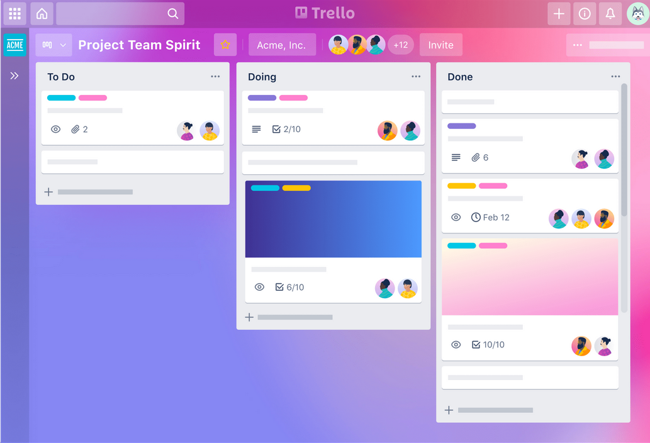
Tool in Depth: Trello
Trello is a web-based, Kanban-style, list-making application that contains easy-to-add cards for organizing and managing tasks
Being a visual tool, Trello organizes your projects into boards
Trello tells you what’s being worked on, who’s working on what, and where something is in a process

Slide 87
Tool in Depth: Asana
Asana’s web and mobile apps help you stay on track, keep projects organized, and hit deadlines
Asana includes a specific set of features such as List, Dashboard, Timeline, Calendar, Archives, Progress, Portfolio, Resource Management, Inbox and My Tasks
Visualize your progress on projects with Asana boards as your team moves tasks from do to done

Slide 88
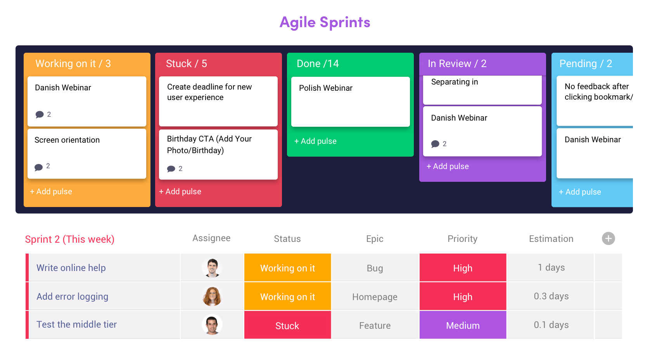
Tool in Depth: Monday
Monday.com is a complete program based on easily manageable items and actions
Manage tasks and workflows with project boards to fuel team collaboration and productivity
Track sales cycle, customer data and more with Monday sales CRM, particularly useful for CRM and Marketing teams

Slide 89
File Storage and Sharing Tools
As non-profit organisations it’s important to have a reliable and secure way to store and share files.
Internal management tools such as Dropbox, Google Drive, and One Drive are based on cloud technology, which means that backups are kept safe and files can be accessed from anywhere.
Dropbox
Google Drive
One Drive

Slide 90
Tool in Depth: Dropbox
Dropbox is a cloud-based storage solution that can be used by non-profit organizations to store and share files
It allows teams to collaborate on projects and bring their ideas to life, whether they’re working alone or with colleagues and clients
With Dropbox, files are backed up to the cloud and available online, making it easy for team members to access their work from anywhere

Slide 91
Tool in Depth: Google Drive
Google Drive is a cloud-based storage solution that can be used by non-profit organizations to store and share files
With Google Docs, Sheets, Slides, Forms, and Sites, teams can work together in the same document in real-time and avoid back-and-forth emails
Google Drive offers a larger free plan (15 GB) but can occasionally cause issues with syncing, converting and sharing third party files

Slide 92
Tool in Depth: Onedrive
OneDrive is the Microsoft cloud service that connects you to all your files
It can be used by non-profit organizations to store and protect files, share them with others, and access them from anywhere on all your devices
OneDrive integrates seamlessly with Microsoft Office and is there answer to the collaboration that Google Drive offers

Slide 93
Internal Communication Tools
These tools provide one-on-one chat, increasing productivity and building safer relationships among colleagues
While project management tools are important, they often don’t allow for much informal communication and digital connection which cannot be undervalued on Digital Teams
Informal conversations allow teammates to build bonds, share knowledge and spark collaboration.
Non-profit organizations can benefit from these tools to enhance internal coordination and knowledge sharing
Slack
Teams
Google Chat

Slide 94
Slack
Slack is a messaging app for business that connects people to the information they need
By bringing people together to work as one unified team, Slack transforms the way organizations communicate. Threads allow for organized conversations
Great for teams that use both Google and Microsoft suite but drawback is that you can’t host calls directly through the app

Slide 95
Microsoft Teams
Microsoft Teams provides tools for nonprofits to collaborate with all parties involved
Connect through virtual meetings and integrate 3rd party tools. Most comprehensive tool for internal communication with channels, direct messages, online video calls and perks of Microsoft OneDrive and other tools
Drawback is that it doesn’t allow as much integration with third party apps as others do

Slide 96
Google Chat
Google Chat is a messaging platform for teams that integrates with Google Workspace
Collaborate in real-time with team members using direct messages or team chat rooms. Particularly useful for the Google suite and the ability to create a room for rapid brainstorming
Use bots to automate tasks and speed up workflows

Slide 97
Internal Communication Tools
Internal channels allow flexible management of documents, conversations, and files in one place, while traditional emails can be time-consuming when searching for conversations and documents
Each tool has pros and cons, so it’s important to explore with your team to choose the tool that best meets your needs
Photo Source

Slide 98
Choosing the right Tool…
When choosing a tool, keep in mind the following…
Integration: It’s important to choose tools that can integrate with the systems and software that your organization is already using. Ease of use: The tools you choose should be user-friendly and intuitive. Scalability: As your organization grows and evolves, your needs may change. It’s important to choose tools that can scale with your organisation. | Security: Ensuring the security of your organization’s data is crucial. Be sure to choose tools that have robust security measures in place to protect your data. Cost: Consider the cost of the tools you are considering, as well as any ongoing costs such as subscription fees or maintenance costs. Support: Choose tools that offer good customer support, so that you can get help quickly if you encounter any issues.

Slide 99
External Communication Tools
External communication tools are the ones used to communicate with external people, target audiences, or clients.
Some of these tools include website, blogging, email, newsletter, social media networks (LinkedIn, Instagram, Facebook, Telegram), conferences, press releases, and events. Having in mind who the target audience is, the strategies to communicate will depend on the tools your target audience is using as well.

Slide 100
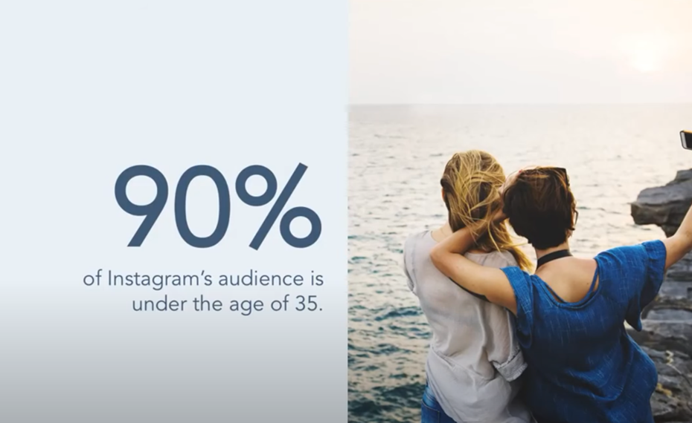
Utilising Social Media
Click here to add photo
Watch this video on Popular Social Media Channels for your Business

Slide 101
Some Tips to Bear in Mind while Communicating
Keep the user first: Knowing the user and the communication preferences will increase the opportunities to reach them. In essence, is about using strategies and adapting the message accordingly based on age, communication style, type of audience, and use of language.
A good practice for knowing the audience is the creation of user personas. The use of user personas will narrow the preferences that each segment has (stakeholders, partners, consumers, etc.).

Slide 102
Some Tips to Bear in Mind while Communicating
Do not push users to information overload: Considering the number of information people receive daily, the communication should be based on the use of keywords to attract the attention of the users and keep them interested.
External communication is about delivering value to each of your audience segments and as a result, connecting with your target audience.

Slide 103
Some Tips to Bear in Mind while Communicating
The use of video: The use of video is extremely important due to the emotional aspects It might awake, as commented in the previous section the use of video will present better retention of the message.
Additionally, videos are a great source for reaching users that prefer visual content.
Create a solid brand: Creating or improving the brand is not an easy step.

Slide 104
Some Tips to Bear in Mind while Communicating
Create a solid brand (cont.): There are several aspects to be considered…
What is the story the brand is trying to tell? The story behind the brand is what makes it unique and different from others.
The use of descriptive but factual words will be important to define the colours of your brand. Examples of nonprofit storytelling.

Slide 105
Some Tips to Bear in Mind while Communicating
Aspects to be considered while creating a solid brand (cont.):
Colours & Fonts: Colours have different meanings, the descriptive words addressed should be in line with the colours used.
In the image following there is a general description of what colours mean, however it is important to bear in mind the cultural particularities and context of the colours used. Not all colours might mean the same in people's different cultural contexts.

Slide 106
Some Tips to Bear in Mind while Communicating
Aspects to be considered while creating a solid brand (cont.):
The fonts used should represent the story associated. Therefore, colours and fonts should be used in the same way, respecting the overall brand.
The brand should be consistent across all the dissemination actions. For further information about brand consistency, visit How to build brand Consistency from Hubspot.

Slide 107
Black is associated with Luxury, elegance, formality, Mystery and power.
White is associated with Cleanliness, simplicity, Faith, Purity and innocent.
Purple is associated with creativity, individuality, royalty, wealth and opulence.
Blue is associated with trust, honesty, authority, wisdom and loyalty.
Red is associated with excitement, action, strength, determination and passion
Orange is associated with happiness, optimism, uplifting, friendliness and fun
Yellow is associated with joy, energy, enthusiasm, optimism and confidence
Green is associated with Hope, Growth, Balance, reasureance and natural.
Building a Brand: Choosing Colours

Slide 108
“Always think outside the box and embrace opportunities that appear, wherever they might be.”
Lakshmi Mittal

Slide 109
Key Performance Indicators (KPIs)
KPIs are indicators that are commonly used to measure the performance of the organization. It helps to evaluate if the actions carried out have had successful outcomes or if there are any gaps to be considered.
Normally it is expressed in percentage values. In this section, the KPIs addressed are based on communication strategies.

Slide 110
KPIs
Preparatory stage: In this stage, the use of SMART objectives (Specific, Measurable, Achievable, Relevant, Time-Bound) will set the previous objectives and expected results the organization is trying to achieve. Using a short statement will help to identify the key indicators.
Specific: By growing my NGO’s LinkedIn followers
Measurable: From 10K to 20K

Slide 111
KPIs
Preparatory stage (cont.):
Achievable: Through three LinkedIn campaigns with influencer partners.
Relevant: Increase the brand awareness
Time-Bound: This year

Slide 112
KPIs
Development stage: KPIs should be relevant to the actual objectives of the Organization. Hence, the KPIs that will be tracked should be in the same line with the current priorities.

Slide 113
KPIs
Development stage (cont.): Examples of KPIs addressed:
Conversion rate (conversions/visits) | Do they subscribe or register?
Depth of visit (page views/visits) | Are they interested in the content?
Content depth (page views content/visits content) | Which content is the most interesting?
New visitor percentage (new visitors/unique visitors) | Are new visitors attracted?
Committed visitor share (visits of more than 5 minutes/total visits) | Are they loyal followers?
Audience engagement (comments, sharing, etc.) | Total of impressions
Sentiment ratio | Positive-neutral-negative Brand mentions/all brand mentions
Source: Information extracted from: Castelló (2012) Del ROI al IOR el retorno de la inversión de la comunicación empresarial y publicitaria en medios sociales

Slide 114
KPIs
Evaluation Stage: This stage is about tracking the performance developed during the development stage. In this stage, it needs to be described how often these KPIs will be tracked. An easy way to keep track of the KPIs is the use of:
Excel and google sheets: Adding frequently the progress of the performance will show how the progress is going and therefore, will determine the concrete actions and strategies to reinforce the performance.
For example: Weekly tracking can be used to evaluate how many people have joined your email list.

Slide 115
Individual Work
Please add the suggested practical exercise, preparation for assessment, other individual studies.
For example, course work to develop and implement an Innovative project with a challenge-based approach. Innovative project is recommended to be developed and implemented together with local stakeholders to addressing the local challenges (section 2.3). After the completion of 6 modules, the TSOs leaders could pitch their Innovation projects for the stakeholders (region/ city/ industry). It will stimulate the bottom-up approach mind-set of TSOs leaders/ TOP managers/ employees and will strengthen interaction, engagement, and a positive effect on the local and regional community.

Slide 116
Challenge based learning
Poverty is well known in your community, and the level of inflation had led many people to struggle with their everyday expenses. The levels of extreme poverty have increased, and public institutions are facing difficulties in answering this issue. On the other hand, your local community is aware of it but there is action to solve the problem.
With this situation, your team has been thinking about how to engage more people and create a campaign of sensibilization to raise awareness.
Now it is your time to act!

Slide 117
Engage: Get to know the challenge
Who are the stakeholders?
Why this idea is important to me?
Why this is relevant?
What type of people are you investigating?

Slide 118
Investigation: research the challenge
Identify your end-users. How do they feel? What are the reasons behind this? What have they tried to overcome the problem? What’s their opinion about public institutions? What types of jobs do they have?
Search resources (blog media posts, articles, videos, etc)
How might we reduce the level of extreme poverty?
How can your team help them?

Slide 119
Action: brainstorm with your team!
Identify your end-users. How do they feel? What are the reasons behind this? What have they tried to overcome the problem? What’s their opinion about public institutions? What types of jobs do they have?
Search resources (blog media posts, articles, videos, etc)
How might we reduce the level of extreme poverty?
How can your team help them?

Slide 120
“Nothing works better than just improving your product.”
Joel Spolsky

Slide 121
Thank you
Any questions?
www.leaderseeds.eu

Slide 122
06
References

Slide 123
Communication Sources
Keyton, J. (2010). Case studies for organizational communication: Understanding communication processes. New York, NY: Oxford University Press.
Welch, M., & Jackson, P. (2007). Re-Thinking Internal Communication: A Stakeholder Approach. Corporate Communications: An International Journal, 12, 177-198.
K Ruck, M Welch - Public relations review, 2012 Valuing internal communication; management and employee perspectives
Bui, Thuy Linh (2019). Internal communication in the digital workplace: digital communication channels and employee engagement

Slide 124
Communication Models and Miscommunication
Jackson, T. W., & van den Hooff, B. (2012). Understanding the factors that affect information overload and miscommunication within the workplace. Journal of Emerging Trends in Computing and Information Sciences. 3(8). 1240-1252.
3 models of communication: hyperlink text: YouTube video
Miscommunication: hyperlink text: YouTube video
Organisational Structures
Organizational Silos and how to prevent them: hyperlink text: Article
Non-Profit Organizational Charts: hyperlink text: Website

Slide 125
Marketing Sources
Inbound Marketing: hyperlink text: Website
Inbound v Outbound Marketing: hyperlink text: Presentation
How to run a lean mean nonprofit marketing machine: hyperlink text: Article
Survey on inbound Marketing: hyperlink text: Article
Customer Journey Mapping
Customer Journey Map: hyperlink text: Article
CJM for Non-Profit: hyperlink text: Article

Slide 126
Storytelling Sources
The Brain and Business of Story: Creating Engaging and Influential Presentations Using Story Structure. SagePresence. 2018.
Storytelling Elements: hyperlink text: Article
Parkinson & Laura (2019). Establishing Trust through Storytelling: A Model for Co-Design.
Jerome Bruner (1990). The Narrative Construction of Reality.

Slide 127
Storytelling Sources
Parkinson & Laura (2019). Establishing Trust through Storytelling: A Model for Co-Design.
Jerome Bruner (1990). The Narrative Construction of Reality.
The Brain and Business of Story: Creating Engaging and Influential Presentations Using Story Structure. SagePresence. 2018.
Storytelling Elements: hyperlink text: Article
Good dialogues within the film industry: hyperlink text: Article

Slide 128
Storytelling Sources
20 best songs that tell a story: hyperlink text: Article
21 beautiful examples of visual Storytelling on Instagram: hyperlink text: Article
25 Plot Twist Ideas and Prompts for Writers: hyperlink text: Article
Castelló (2012) Del ROI al IOR el retorno de la inversión de la comunicación empresarial y publicitaria en medios sociales.
How to build brand Consistency: hyperlink text: Website

